Slide 1

Demonstration Report:
FSO System Prototype Based on FPGA
2026.10.23
Prof. Jang Yeong Min
Kookmin University, Seoul, Korea
Wireless Communications and Artificial Intelligence Lab.
https://wireless.kookmin.ac.kr

Slide 2
Presentation Overview
Explanation of Previous System (14 August 2026) (Slide 3-5)
Problem of Previous System (Slide 6)
Solution and How to Solve the Problem (Slide 7)
New System Architecture (Slide 8 & 9)
Result of New System (Simulation Based) (Slide 10-15)
Hardware Demo (Slide 16-19)
Detailed System Update for System Architecture (Slide 20-24)
ARQ Selective Repeat (Slide 25-27)
Future Plan of Research and Paper (Slide 28-31 )
Detailed System Explanation for Each Module (Slide 32-82)
‹#›

Slide 3
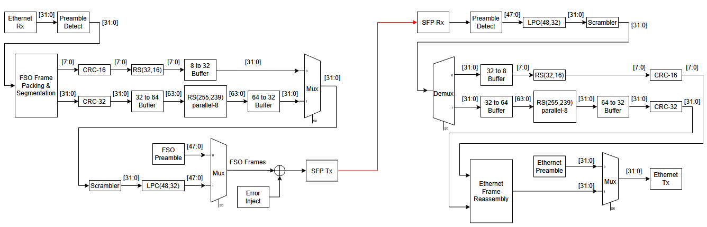
System Architecture (previous system)
System Architecture (14 August 2026)
This process for SDA Frame Encoder
This process for SDA Frame Decoder
‹#›

Slide 4
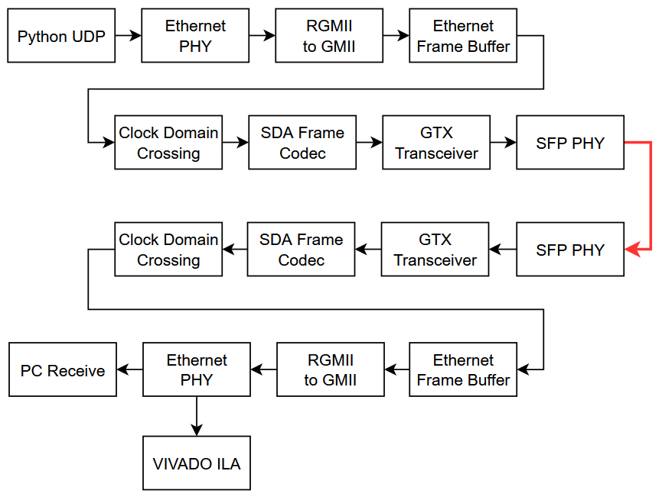
System Architecture (previous system)
System Architecture (14 August 2026)
This process for SDA Frame Encoder
This process for SDA Frame Decoder
‹#›

Slide 5
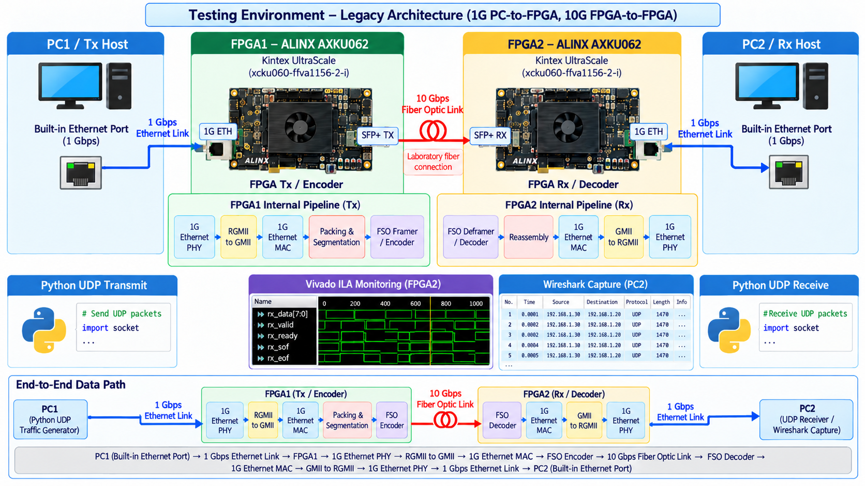
System Architecture (previous system)
System Architecture (14 August 2026)
‹#›

Slide 6






Previous System Problem (Demo 14 August 2026)
Previous data path
PC1
RGMII 1 Gbps
FPGA TX
SDA Encoder
Fiber Optic Link
FPGA RX
SDA Decoder
RGMII 1 Gbps
PC2
Bottleneck: the 10G optical link is fed by a 1 Gbps RGMII Ethernet interface
1 Gbps data input
Throughput instability
No multi-frame support
PC side uses RGMII (1G Ethernet), far below the 10 Gbps optical line rate.
Data rate fluctuates between 6.1 Gbps and 8 Gbps; not fixed to SDA OISL Table 2-4.
Data longer than one FSO payload is not segmented across consecutive frames.
Frame gap 10 ns
No error injection
ARQ not implemented
Gap between FSO frames; SDA OISL requires a continuous frame stream.
No controlled way to inject bit errors and verify FEC / CRC behaviour.
Lost or corrupted frames are not retransmitted.
‹#›

Slide 7
How We Resolved the Problem ?
New modules following SDA OISL v2.1.2 · 43 custom modules + 9 IP cores = 52 architectural blocks (TX + RX)
1 Gbps RGMII input
10GBASE-R over SFP+ (Intel X520 NIC) → XGMII 32-bit @ 312.5 MHz
Complete
Fluctuated Throughput
6.1 – 8 Gbps
Fixed frame timing per OISL Table 2-4: 2.4936 µs / frame and 6.121 Gbps Effective Data Rate
Complete
Frame gap 10 ns
By Adding Multiplexer and Fifo Buffer for Arbitration (Multiframe Mux) and transmit idle when No Data / MGMT.
Complete
No multi-frame
Adding Multiframe Module (Payload, Idle, MGMT, MUX Arbitration) based on SDA OISL Figure 2-6
Complete
No error injection
Error Injector: simulation mode (error.mem XOR) and hardware mode (manual VOA)
Complete
ARQ not implemented
ARQ Selective Repeat (SDA OCT method with SDA OISL header parameters)
In progress
‹#›

Slide 8
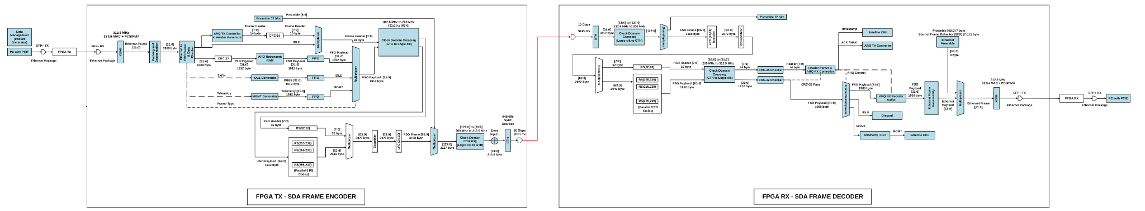
System Architecture (proposed system structure)
Blue color: New Module
Architecture Upgrade Summary Total Update :
New Custom Modules: 43 Modules
New IP Cores / Buffers: 9 IPs
Total Architectural Changes: 52 Blocks
FPGA TX (Encoder) - Architecture Upgrade Summary Total Update (Encoder Only):
New Custom Modules: 25 Modules
New IP Cores / Buffers: 4 IPs
Total Architectural Changes: 29 Blocks
FPGA RX (Decoder) - Architecture Upgrade Summary Total Update (Decoder Only):
New Custom Modules: 18 Modules
New IP Cores / Buffers: 5 IPs
Total Architectural Changes: 23 Blocks
‹#›

Slide 9
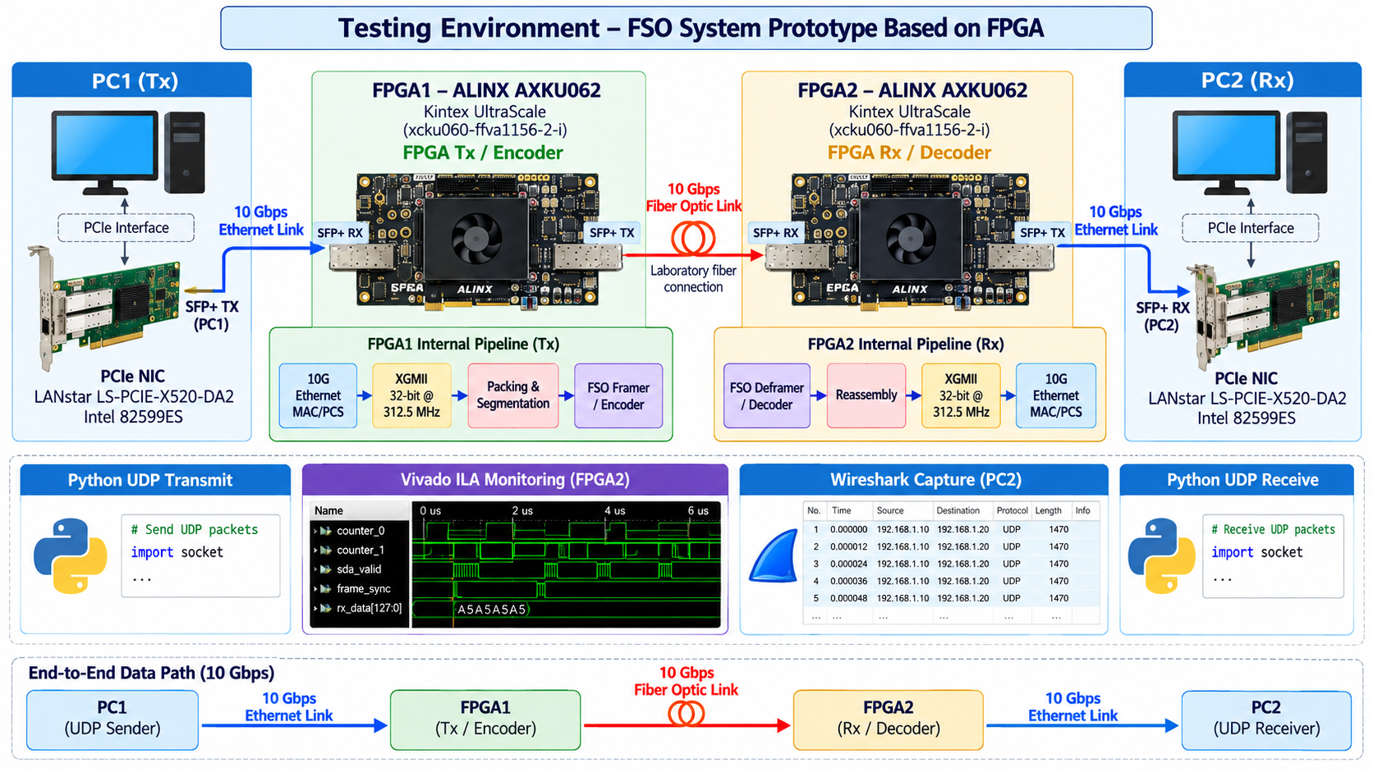
New Testing Environment
‹#›

Slide 10
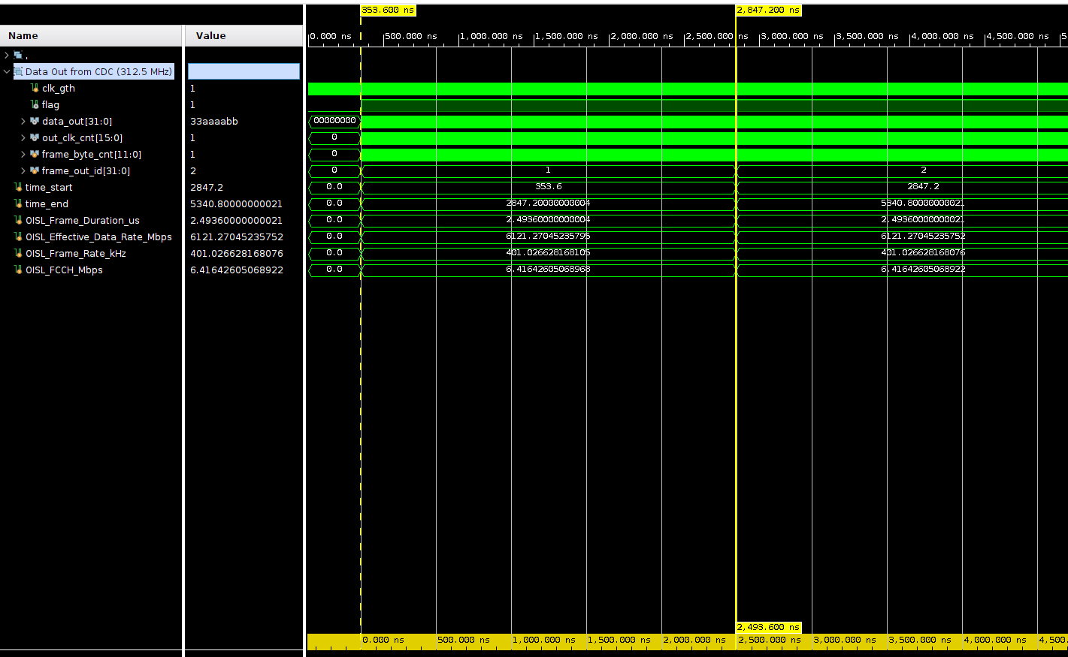
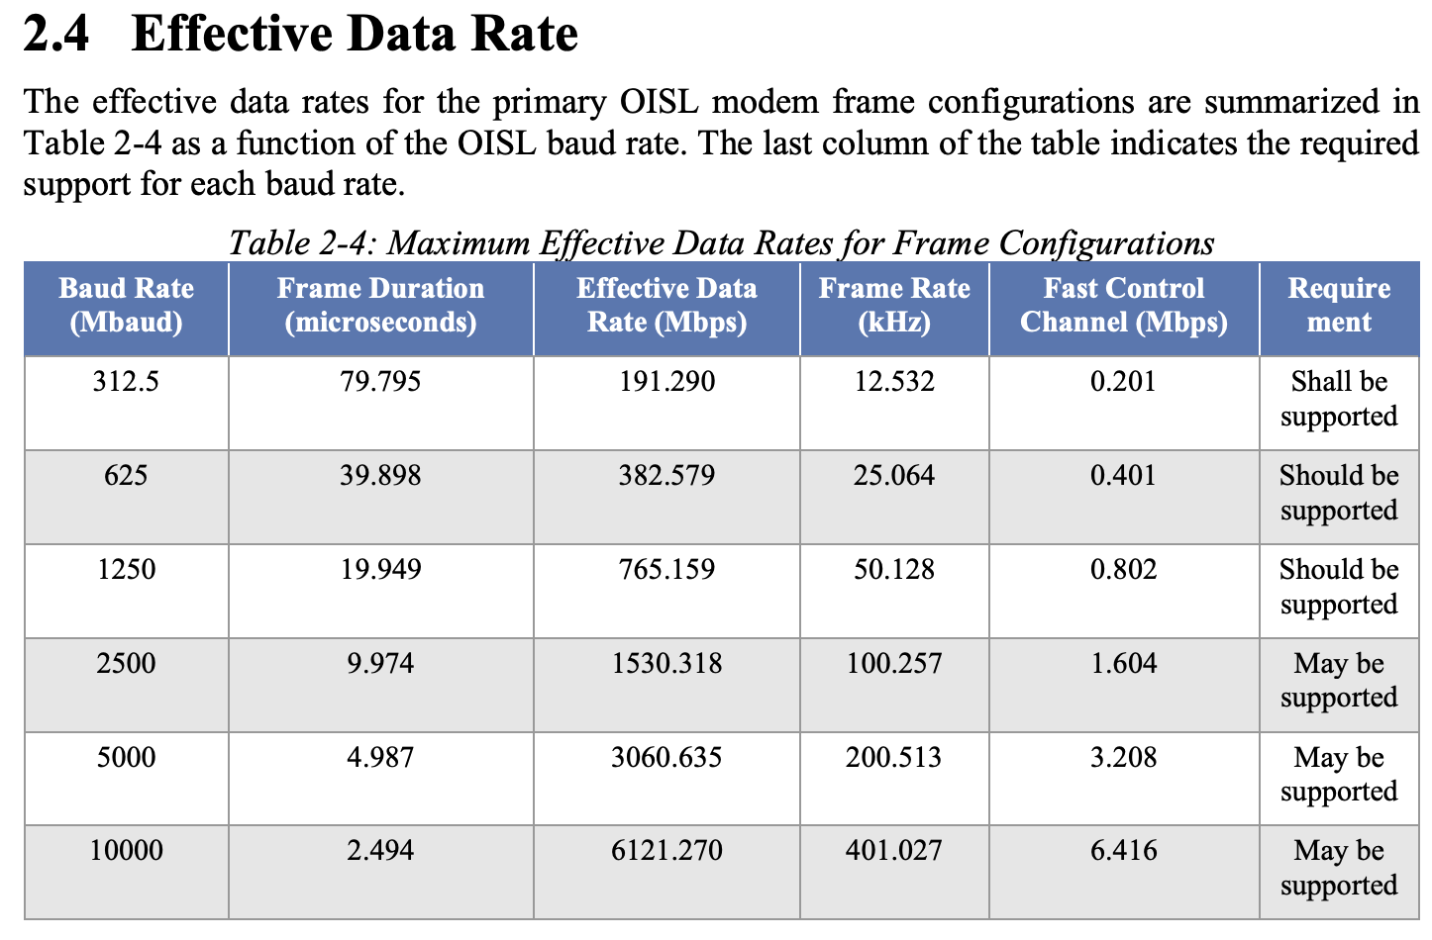



Effective Data Rate
Following SDA OISL Table 2-4: Maximum Effective Data Rates for Frame Configurations
Frame Duration
= Total Frame / 10 Gbps
= 24936 bit / 10 Gbps
= 2.4936 us
Baud Rate | Frame Duration | Effective Data Rate | Frame Rate | Fast Control Channel
10000 Mbaud (312.5 MHz x 32 Bit = 10 Gbps) | 2.4936 us (In this slide show 2,493.600 ns) | 6121.270 Mbps (6,121 Gbps) | 401.0266 kHz | 6.416 Mbps
Data Rate for one data
Effective Payload Data Rate
Payload = 1908 Byte = 15,264 bit
FCCH (Fast Control Channel 16-bit)
Frame Rate
‹#›

Slide 11


Task Completed
0 ns
2.4936 µs
6121.27
Frame gap
Frame duration
Mbps effective data rate
3117-byte frames sent back-to-back
24,936 bits at 10,000 Mbaud
Matches SDA OISL Table 2-4
pipeline following SDA OISL (simulation verified)
XGMII
10G
Packing &
Segment.
Header
+ CRC-16
Payload
+ CRC-32
CDC
312.5→200
RS(32,16)
RS(255,239)
Scrambler
LPC
Preamble
+ MUX
CDC → GTH
Frame gap solved
Data rate following SDA OISL
ARQ – still in development
All modules following SDA OISL
Error injector (simulation + hardware mode)
Memory visibility · RAM usage · Retransmit & reorder
‹#›

Slide 12
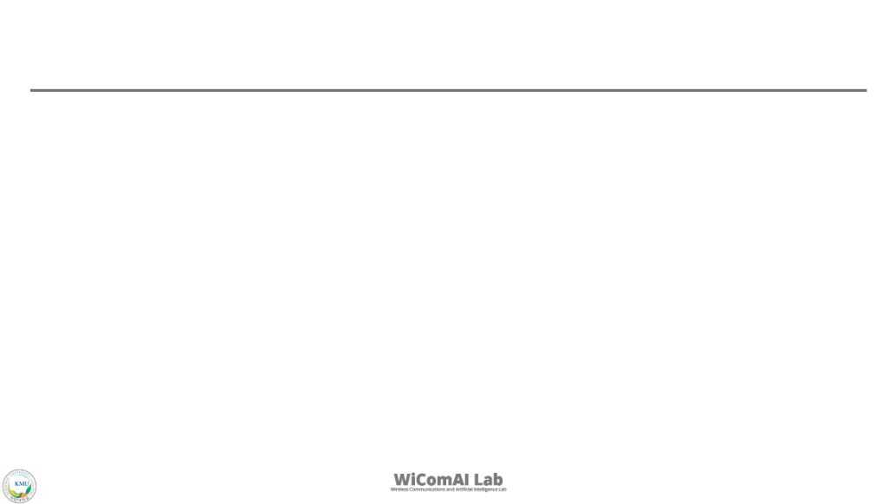
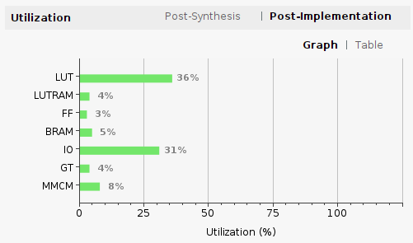
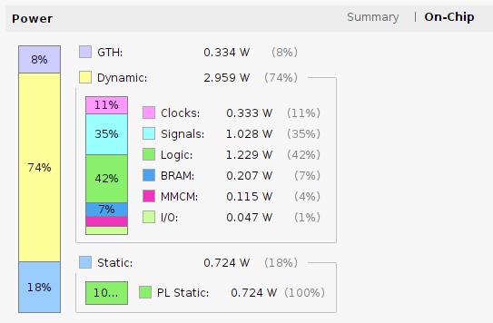
Power Consumption & Resource Utilization
Vivado post-implementation report · Kintex UltraScale XCKU060-FFVA1156
4.02 W
30.6 °C
2.96 W
0.72 W
Total on-chip power
Junction temperature
Dynamic power (74%)
Static power (18%)
Power to off-chip devices: 0 W
Thermal margin 69.4 °C (47.4 W)
Mostly logic and signal switching
Leakage, independent of activity
Logic + signals = 2.26 W (56%) of the total; the 10G optical interface (GTH) needs only 0.33 W. Impact on the project: next slide.
Confidence: Low (vectorless estimate) – to be confirmed by on-board measurement.
‹#›
Notes:
Total on-chip power is 4.016 W with a junction temperature of 30.6 C, so the thermal margin is large (69.4 C). Dynamic power is 2.959 W (74%): logic 1.229 W and signals 1.028 W dominate, clocks 0.333 W, BRAM 0.207 W, MMCM 0.115 W, I/O 0.047 W. The GTH transceivers use 0.334 W and static leakage is 0.724 W. Utilization: LUT 36%, IO 31%, MMCM 8%, BRAM 5%, LUTRAM 4%, GT 4%, FF 3%. Vivado marks the confidence as Low because no switching-activity file was used, so these numbers are an estimate.

Slide 13
Impact on the FPGA Project
What the Vivado post-implementation report means for the Encoder + Decoder design
36% LUT used
5% BRAM used
4.016 W
64% LUT capacity remains
External DDR still needed for ARQ
Vivado on-chip power estimate
1 RESOURCE HEADROOM
2 POWER & THERMAL
Space for additional FPGA functions
An initial baseline, not a hardware measurement
LUT 36% and BRAM 5% used in this design.
4.016 W on-chip; estimated junction temperature 30.6°C.
Low utilization alone does not guarantee timing closure.
74% dynamic power → real traffic activity matters.
3 HIGH-SPEED TIMING
4 SYSTEM-LEVEL SCALING
Timing closure is the next critical gate
ARQ and net payload rate need separate validation
Check WNS/TNS and critical paths at the selected clocks.
BRAM 5% does not include a validated DDR ARQ budget.
If needed: 64-bit @ 156.25 MHz + FIFO/CDC redesign.
10-Gb/s OISL signaling ≠ 10-Gb/s Ethernet payload.
NEXT VALIDATION
1. Measure board power & temperature 2. Test ARQ/DDR + end-to-end UDP
Vivado power confidence: LOW. Values describe the implemented design; they do not establish total board power or end-to-end system compliance.
‹#›
Notes:
Total on-chip power is 4.016 W with a junction temperature of 30.6 C, so the thermal margin is large (69.4 C). Dynamic power is 2.959 W (74%): logic 1.229 W and signals 1.028 W dominate, clocks 0.333 W, BRAM 0.207 W, MMCM 0.115 W, I/O 0.047 W. The GTH transceivers use 0.334 W and static leakage is 0.724 W. Utilization: LUT 36%, IO 31%, MMCM 8%, BRAM 5%, LUTRAM 4%, GT 4%, FF 3%. Vivado marks the confidence as Low because no switching-activity file was used, so these numbers are an estimate.

Slide 14



This Year Plan (2026)
Half-Duplex → Full-Duplex
ARQ Implementation
Hardware Implementation & Demo
Final Report
12 – 23 Oct
26 Oct – 6 Nov
9 – 20 Nov
23 Nov – 1 Dec
Sprint 5
Current
Sprint 6
Planned
Sprint 7
Planned
Sprint 8
Planned
RX Pipeline, Simulation & ETRI Demo
Hardware Implementation, Python BER Ecosystem & Validation
Full-Duplex Prototyping
Final Submission
GTH RX, ARQ RX, end-to-end simplex sim, ILA setup, live demo
Python automation, RS(255,239) limit validation
Full-duplex integration, stress test
Architecture / schematic doc, ARQ viability report, ETRI handoff
‹#›

Slide 15


Module Reference
XGMII / 10G Ethernet
IEEE 802.3
XGMII (Clause 46), 10GBASE-R PCS (Clause 49): IDLE 0x07, IPG ≥ 12 bytes, preamble / SFD
SDA Encoder & Decoder
SDA OISL v2.1.2
Frame format, CRC-16 / CRC-32, RS(32,16) header, RS(255,239) payload, scrambler, LPC, preamble (Sec. 2.6.3, Table 2-4)
GTH Transceiver
AMD Xilinx PG182 & UG576
UltraScale Transceivers Wizard (PG182) and GTH Transceivers User Guide (UG576)
ARQ
SDA OCT v4.0.0 + SDA OISL v2.1.2
Technical Selective Repeat procedure from SDA OCT, using SDA OISL header parameters
‹#›

Slide 16


Hardware Demo
PC1 (TX)
FPGA1
FPGA2
PC2 (RX)
X520 NIC
UDP / TCP sender
SFP+ 10G
AXKU062
SDA Encoder
Patch cord
(+ manual VOA)
AXKU062
SDA Decoder
SFP+ 10G
X520 NIC
Wireshark / receiver
Demo procedure
1
Calibration
2
Send traffic
3
Monitor
4
Verify
Connect PC1 ↔ PC2 with a patch cord; check SFP+ link up.
PC1 sends UDP / TCP packets through the PCIe X520 NIC at 10 Gbps.
Vivado ILA on FPGA2 shows frame sync, CRC status and recovered data.
Wireshark on PC2 captures the packets; compare sent vs received count and throughput.
Hardware Preparation – Demo on 23 October 2026
Full Hardware Demo on 01 December 2026
‹#›

Slide 17
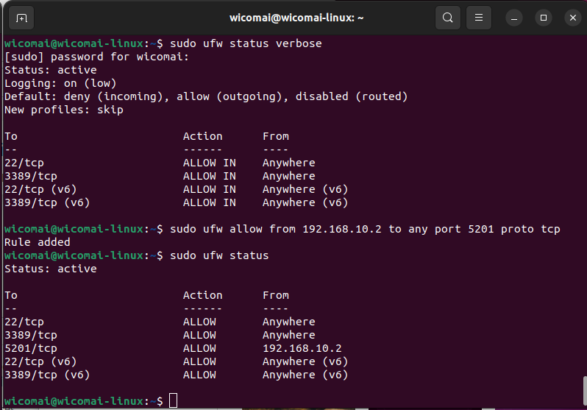
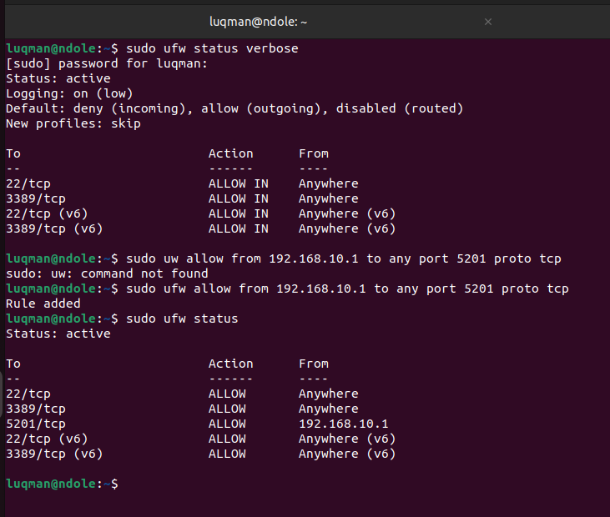
Hardware Demo – Calibration Setup
Step 1: before the FPGAs go into the path, the two PCs are linked directly with a fiber patch cord to measure the best-case 10G link (baseline).
PC1 TX
Fiber patch cord · SFP+ 10 Gbps
PC2 RX
192.168.10.1 · PCIe X520 NIC (SFP+)
No FPGA in the path (calibration)
192.168.10.2 · PCIe X520 NIC (SFP+)
Firewall on PC 1
Firewall on PC 2
1
Connect
SFP+ patch cord between the two X520 NICs, static IPs 192.168.10.1 (PC 1) and 192.168.10.2(PC 2).
2
Open port 5201
ufw allows TCP 5201 (iperf3) only from the peer PC.
3
Measure
ping both ways, then iperf3 TCP in both directions (next slide).
‹#›

Slide 18
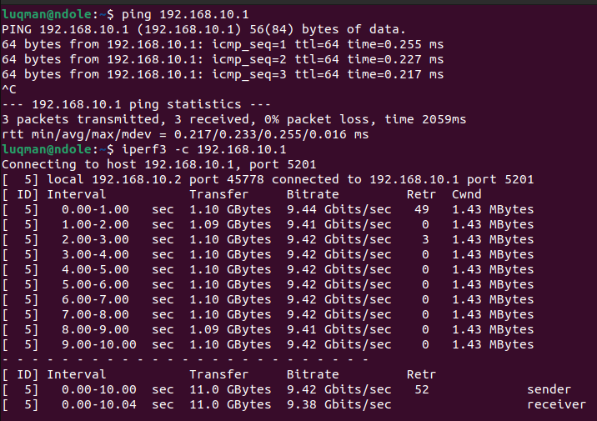
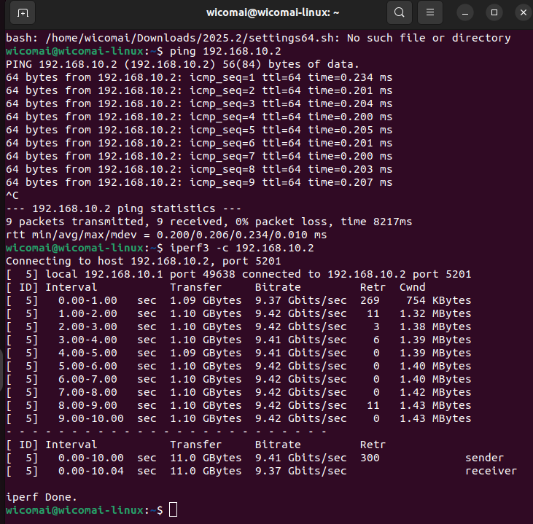
Hardware Demo – Calibration Result
This is testing calibration between PC1 and PC2 ping and iperf3 (TCP, 10 seconds) in both directions over the patch cord.
(PC 2) → (PC 1)
(PC 1) → (PC 2)
≈ 0.2 ms
ping round trip, 0% packet loss
9.42 Gbps
TCP sender (9.37–9.38 at receiver), both directions
52 / 300
TCP retransmissions, mostly in the first second while TCP ramps up
Why 9.42 and not 10 Gbps? Each 1448-byte TCP payload uses a 1538-byte slot on the wire (Ethernet, IP and TCP headers, preamble, IPG): 10 Gbps × 1448 / 1538 ≈ 9.41 Gbps. So PCs, NICs and patch cord already run at full 10G. Later with the FPGA OISL link in the path, the ceiling becomes 6.12 Gbps (OISL Table 2-4).
‹#›

Slide 19
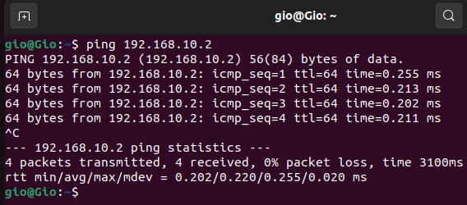
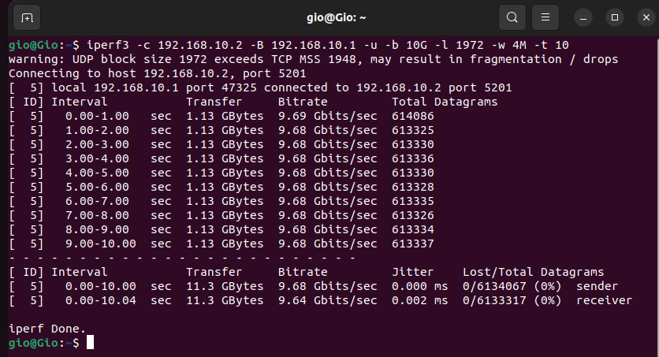
Hardware Demo – Calibration Result
This is testing calibration between PC1 and PC2 ping and iperf3 (UDP, 10 seconds) in both directions over the patch cord.
(PC 1) → (PC 2) Ping Test
(PC 1) → (PC 2) UDP Packet Test
≈ 0.22 ms
ping round trip, 0% packet loss
9.68 Gbps
UDP sender (9.37–9.38 at receiver), both directions
0% loss
0 of 6,133,317 datagrams lost, jitter 0.002 ms
Why 9.68 and not 10 Gbps? Each 1972-byte UDP payload takes a 2038-byte slot on the wire (28 B UDP/IP header + 38 B Ethernet header, FCS, preamble and gap): 10 Gbps × 1972 / 2038 ≈ 9.68 Gbps. So the PCs, NICs and patch cord already carry full 10G with no loss. With the FPGA OISL link in the path, the ceiling becomes 6.12 Gbps (OISL Table 2-4).
‹#›

Slide 20
Detailed System Update
Detail Explanation for New System Architecture

Slide 21
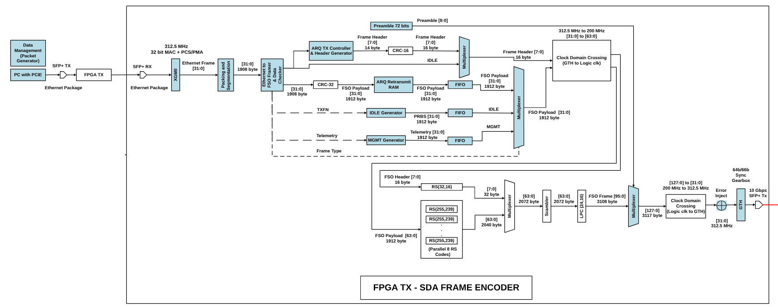
System Architecture (proposed system structure)
Blue color: New Module
‹#›

Slide 22
System Architecture (proposed system structure)
FPGA TX (Encoder) - Architecture Upgrade Summary Total Update (Encoder Only):
New Custom Modules: 25 Modules
New IP Cores / Buffers: 4 IPs
Total Architectural Changes: 29 Blocks
1. System Input & XGMII Front-End (Total: 4 Modules, 1 IP)
Create Module – Data Management / Packet Generator (PCIe/NIC Simulator)
Create Module – XGMII Parser
Create Module – Ethernet Preamble Remover
Create Module – Packing and Segmentation
Create IP – 10G Ethernet PCS/PMA (MAC + PHY)
2. SDA Framer & Payload Multiplexing (Total: 15 Modules, 1 IPs)
Create Module – Ethernet to FSO Framer & Data Checker
Create Module – FSO Header Generator
Create Module – CRC 16
Create Module – FSO Header MUX
Create Module – FSO Payload
Create Module – 3x CRC 32 (DATA & IDLE & MGMT)
Create Module – IDLE Payload Generator
Create Module – Telemetry / MGMT Generator
Create Module – Header Multiplexer (Frame Header & IDLE)
Create Module – Payload Multiplexer (DATA & IDLE & MGMT)
Create Module – 3x FIFO Buffers (for Payload, IDLE, and MGMT synchronization)
Update IP – Clock Domain Crossing Async FIFO (312.5 MHz to 200 MHz)
3. ARQ TX Management (Total: 2 Module)
Create Module – ARQ TX Controller
Create Module – ARQ Retransmit RAM (Memory/Buffer Controller)
4. Post-FEC & Egress Pipeline (Total: 3 Modules, 2 IPs)
Create Module – Preamble 72-bit Generator
Create Module – Multiplexer for Preamble and LPC
Create Module – Error Injector
Update IP – Clock Domain Crossing Async FIFO (200 MHz to 312.5 MHz)
Create Module – 64b/66b Sync Gearbox TX: Verilog code to encode and align 32-bit payloads into 64b/66b blocks with sync headers.
Create IP – GTH Transceiver (10 Gbps SFP+ TX with 64b/66b Gearbox)
‹#›

Slide 23
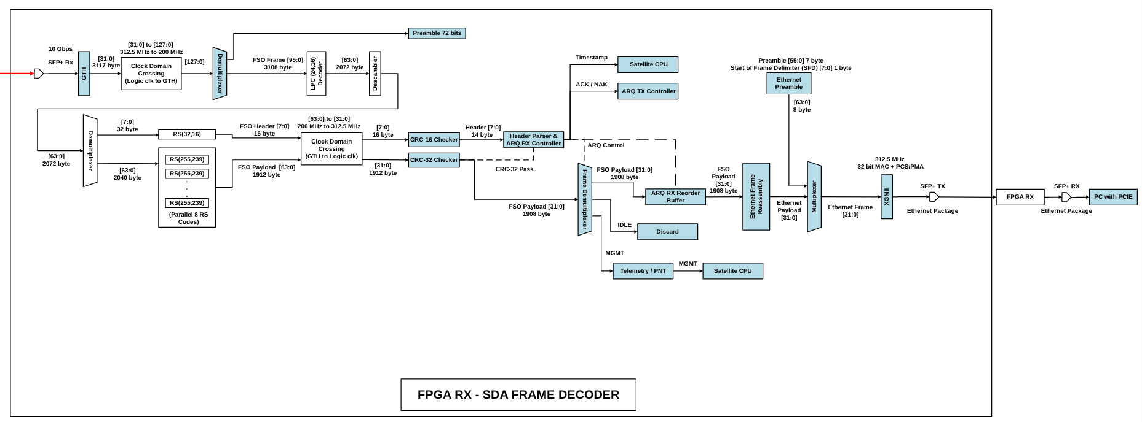
System Architecture (proposed system structure)
Blue color: New Module
‹#›

Slide 24
System Architecture (proposed system structure)
FPGA RX (Decoder) - Architecture Upgrade Summary Total Update (Decoder Only):
New Custom Modules: 18 Modules
New IP Cores / Buffers: 5 IPs
Total Architectural Changes: 23 Blocks
3. ARQ & Frame Routing Management (Total: 7 Modules, 1 IP)
Create Module – CRC 16 Checker
Create Module – Header Parser
Create Module – ARQ RX Controller (Evaluates CRC status and generates ACK/NAK signals for the ARQ TX Controller).
Create Module – CRC 32 Checker
Create Module – Frame Demultiplexer (Dynamically routes the 1908-byte payload based on its Frame Type indicator).
Create Module – MGMT Extractor (Extracts timestamp data for the Satellite CPU).
Create Module – IDLE Discard (Safely drops dummy IDLE frames from the pipeline).
Create IP – ARQ RX Reorder Buffer (Buffers and re-sequences out-of-order 1908-byte payloads before reassembly).
4. Payload Reassembly & Egress Back-End (Total: 5 Modules, 1 IPs)
Create Module – Ethernet Frame Reassembly (Stitches the 1908-byte FSO payloads back into their original, dynamic-sized Ethernet frames).
Create Module – Ethernet Preamble Generator (Generates the standard 7-byte Preamble and 1-byte SFD).
Create Module – Ethernet Multiplexer (Combines the standard Ethernet Preamble with the reassembled Ethernet Payload).
Create Module – XGMII TX Formatter & IPG: Verilog code to insert Terminate (0xFD) and 12-byte Inter-Packet Gap.
Create Module – Ethernet MAC Packing (Dynamic Ethernet MAC Transmit Stream Packer)
Create IP – XGMII Formatter & 10G PCS/PMA TX (Formats the 32-bit data and transmits the rebuilt Ethernet packages via SFP+ TX to the Receiver PC)
1. Physical Ingress & Synchronization (Total: 3 Modules, 2 IPs)
Create IP – GTH Transceiver RX (Receives the 10 Gbps optical signal via SFP+).
Create Module – 64b/66b Sync Gearbox RX: Verilog code to achieve block lock and decode 64b/66b blocks back to 32-bit data.
Update IP – Clock Domain Crossing / CDC (Bridges 312.5 MHz GTH clock to 200 MHz Logic clock for baseband processing).
Create Module – Demultiplexer (Separates the 3108-byte FSO frame and Preamble).
Create Module – Preamble Extractor (Extracts the 72-bit Preamble to maintain continuous data stream synchronization).
2. Data Validation & Post-FEC CDC (Total: 3 Modules, 1 IP)
Create Module – Header & Payload Demultiplexer (Splits the decoded stream into a 32-byte header and a 2040-byte payload for error checking).
Update IP – Clock Domain Crossing / CDC (Bridges the 200 MHz baseband data back to the 312.5 MHz domain after FEC decoding).
Update Module – CRC-16 Checker (Validates the integrity of the 14-byte Frame Header).
Update Module – CRC-32 Checker (Validates the integrity of the 1908-byte FSO Payload).
‹#›

Slide 25
ARQ Selective Repeat
Detailed Explanation for ARQ

Slide 26
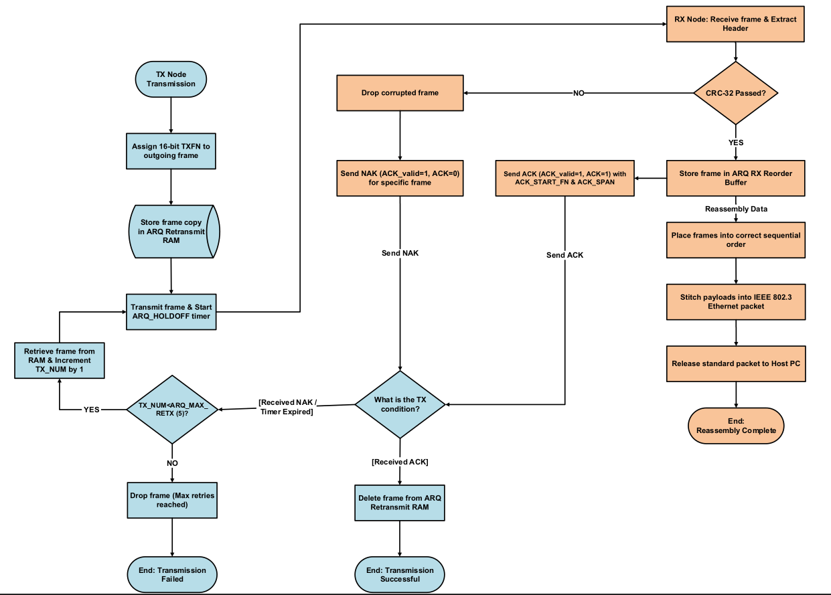
ARQ Selective Repeat
The initial development of the Automatic Repeat Request (ARQ) system was based on SDA OISL Standard v2.1.2, particularly for the frame header structure, ARQ configuration parameters, and acknowledgement (ACK/NAK) signaling.
During further development, SDA OCT Standard v4.0.0 was adopted as an additional technical reference to clarify the operational aspects of ARQ, including frame identification, retransmission control, buffer management, and in-order frame delivery.
Reference -> SDA OCT with SDA OISL Parameter
‹#›

Slide 27
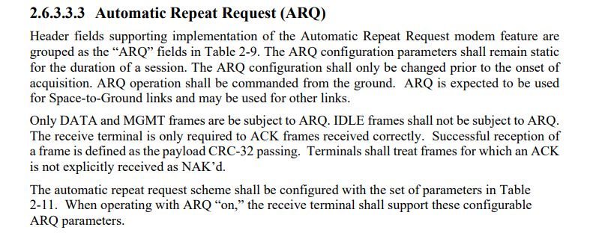
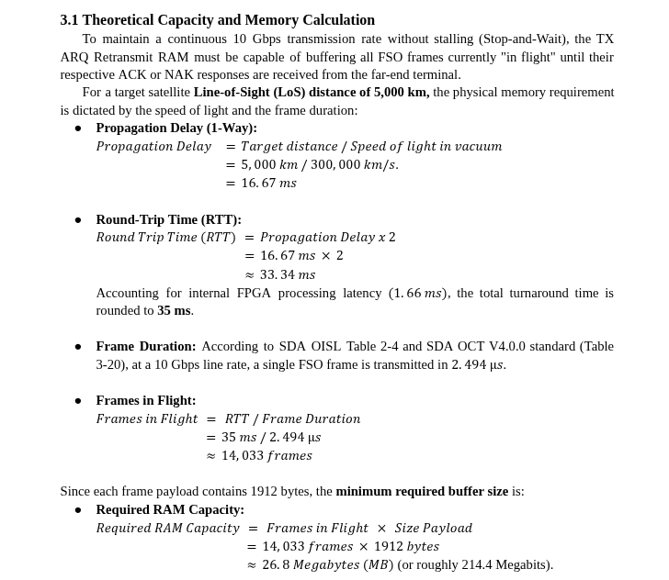
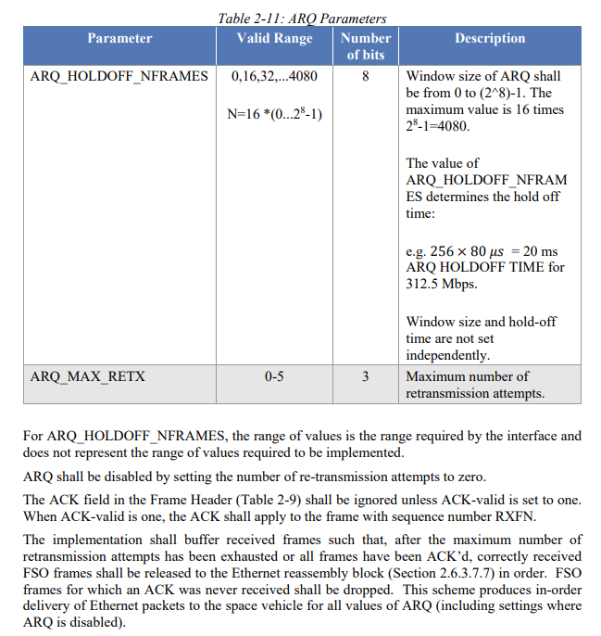
ARQ Selective Repeat (2)
‹#›

Slide 28
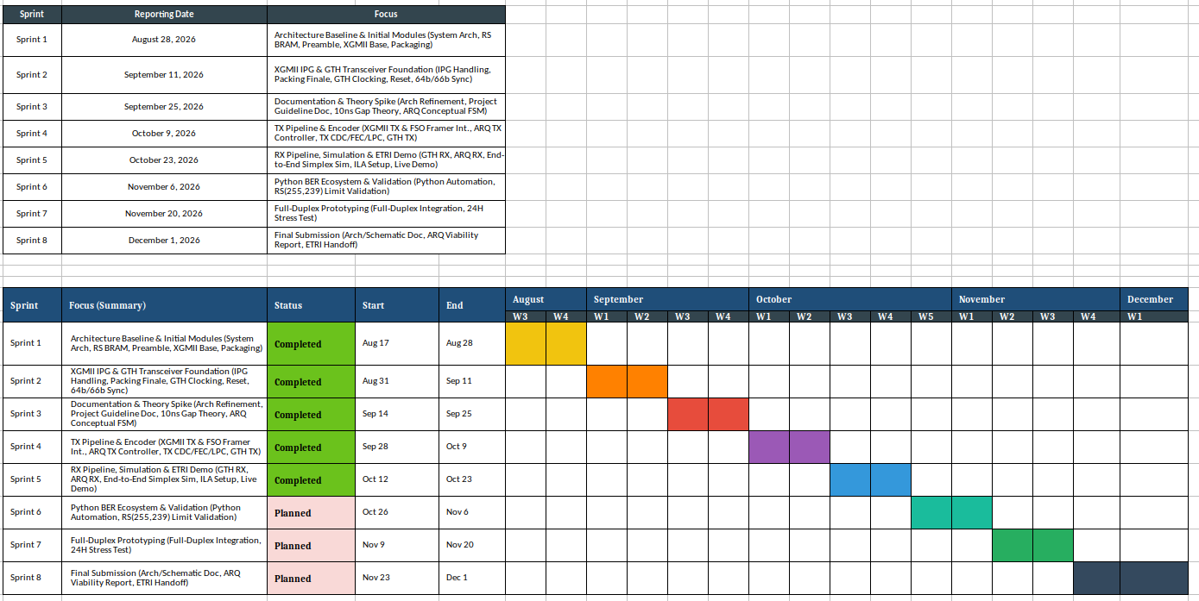
Project Plan
‹#›

Slide 29
Future Plan (28 September 2026)
Feature / Metric | SDA OISL V2.1.2 Standard (Current) | SDA OCT V4.0.0 Standard (Next-Gen. US Standard) | ESA ESTOL v3.1 Standard (European Standard)
Physical Optical Signaling Rate | 10 Gbps (10000 Mbaud physical optical link). (Ref: SDA OISL Sec. 2.6.3) | 10 Gbps (10000 Mbaud physical optical link via GTH). (Ref: SDA OCT V4.0.0 Sec. 3.3) | 10 Gbps (11.3 Gbaud physical optical link). (Ref: ESTOL v3.1 Sec. 3.5.1)
Net Effective Data Rate (Throughput) | 6.1 Gbps max net effective throughput due to LPC and RS overhead. (Ref: SDA OISL Sec. 2.4, Table 2-4) | Up to 1.17 Gbps (PL_RATE 4 high protection) / 1.73 Gbps (PL_RATE 2). (Trade-off: High redundancy/coding gain for 5000 km ultra-long distance S2S links) LDPC provides a very massive additional coding gain, about 3 to 4 dB higher than Reed-Solomon, approaching the Shannon Limit (maximum physical limit of communication) (Ref: SDA OCT V4.0.0 Sec. 3.4.9, Table 3-20) | Up to 10.0 Gbps net user data rate upper bound (leaner frame without LPC). (Ref: ESTOL v3.1 Sec. 3.5.1)
Payload FEC Algorithm | Reed-Solomon RS(255, 239) with interleaving depth 8. Ref: SDA OISL Sec. 2.6.3.6.3) | 5G NR LDPC (Base Graph 1) with variable code rates. (Ref: SDA OCT V4.0.0 Sec. 3.4.5.3) | Reed-Solomon RS(255, 239) with interleaving depth 8. (Ref: ESTOL v3.1 Sec. 3.5.3, ESTOL-OOK-43110)
Header FEC | Reed-Solomon RS(32, 16). (Ref: SDA OISL Sec. 2.6.3.6.4) | Convolutional Code 1/6. (Ref: SDA OCT V4.0.0 Sec. 3.4.5.2) | Convolutional Code 1/6. (Ref: ESTOL v3.1 Sec. 3.5.3, ESTOL-OOK-43120)
‹#›

Slide 30
Future Plan for SCIE Paper (28 September 2026)
Tentative Title | Journal Name | IF | JCR IF % | Rating | Submission Date | WiComAI Lab Team
FPGA-Based Edge AI Acceleration Across Kintex, Alinx, and Zynq Platforms: A Comprehensive Survey and Application Case Study on Free Space Optics | IEEE Wireless communications | 13.4 | 4 % | Q1 | March 2027 | FPGA
AM-Tone-Assisted Beam Acquisition for Optical Inter-Satellite Links Under Pointing Uncertainty | IEEE Internet of Things Journal | 8.7 | 5.8 % | Q1 | April 2027 | PAT
Reliable FPGA Architectures for Free-Space Optical and Inter-Satellite Communication: A Survey of Error Control, Fault Tolerance, and Link Recovery | IEEE Internet of Things Journal | 8.7 | 5.8 % | Q1 | Sept. 2027 | FPGA
Disturbance-Aware Predictive Fine-Pointing Control for Optical Inter-Satellite Communication Under Spacecraft Jitter | Alexandria Engineering Journal | 6.4 | 7 % | Q1 | Dec. 2027 | PAT
‹#›

Slide 31
Future Plan (28 September 2026)
Phase | Development Content & Objectives | Theoretical Foundation | WiComAI Lab Team
Year 1 (2027) (Months 1 - 12) | Baseband Extension Following SDA OCT: Benchmarking alternative following the SDA OISL as the baseline with other Standards that are SDA OCT, and ESTOL v3.1 over wired SFP+. | Error Control Coding, FEC, SDA OISL, SDA OCT, ESA ESTOL | FPGA Team
Year 2 (2028) (Months 13 - 24) | Baseband Extension Following ESA ESTOL: Benchmarking alternative following the SDA OISL as the baseline with other Standards that are SDA OCT, and ESTOL v3.1 over wired SFP+. | Error Control Coding, FEC, SDA OISL, SDA OCT, ESA ESTOL
Year 1 (2027) (Months 1 - 6) | AM Tone Modulation Modeling: Establishing PAT baseline via SDA OISL V2.1.2 before developing simulation models for the advanced 40/50 kHz AM Tone generator with dynamic MI scaling. | Amplitude Modulation, SDA OISL V.2.1.2 , SDA OCT V4.0 Standard | PAT Team
Year 1 (2027) (Months 7 - 12) | AM Tone Demodulation Algorithms: Formulating signal processing algorithms to accurately extract AM Tone magnitude and phase from simulated receiver data. | Signal Demodulation, Digital Signal Processing, SDA OISL V.2.1.2 , SDA OCT V4.0 Standard
Year 2 (2028) (Months 13 - 18) | PAT State Machine Integration: Synthesizing modulation and demodulation models to build the autonomous spatial acquisition and tracking sequence. | Control Theory, SDA OISL V.2.1.2 PAT Protocol, SDA OCT V4.0 Standard PAT Protocol
Year 2 (2028) (Months 19 - 24) | System Simulation & Evaluation: Evaluating the end-to-end tracking lock performance under simulated S2S link conditions and generating final reports. | Optical Beam Tracking, System Optimization, SDA OISL V.2.1.2 , SDA OCT V4.0 Standard
‹#›

Slide 32
Detailed System Explanation
Explanation of all the system by the module with detail

Slide 33
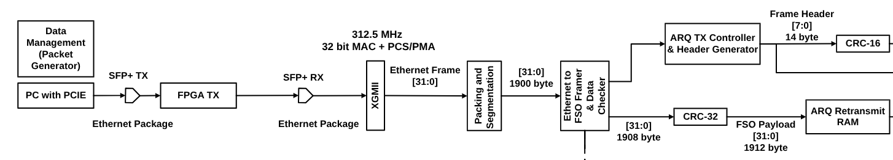
New Module for XGMII TX –
XGMII System Architecture
XGMII - 32 bit Testing
We used packet generator to send ethernet data with jumbo frame (2000 byte data)
XGMII 32-bit Interface @ 312.5 MHz
• Receives 10-Gbps Ethernet data from MAC/PCS-PMA
• Transfers 32 bits (4 bytes) per clock cycle at 312.5 MHz -> 10 Gbps
• Detects and removes Ethernet Preamble (7 bytes) and SFD (1 byte)
• Extracts the valid Ethernet frame for the
Packaging and segmentation of ethernet frames to conform to the FSO frame format following SDA OISL. Ethernet Frame will send 1900 Byte + 8 Byte FSO Payload Header (Following table 2-18)
Data :
Packaging threshold -> 1900 byte
Segmentation threshold -> 1900 byte
‹#›

Slide 34
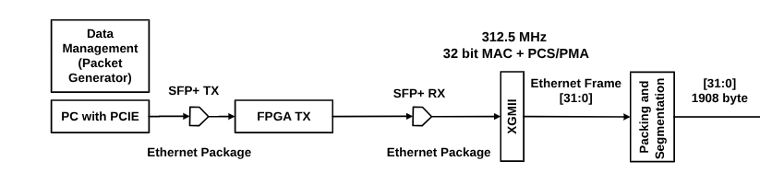
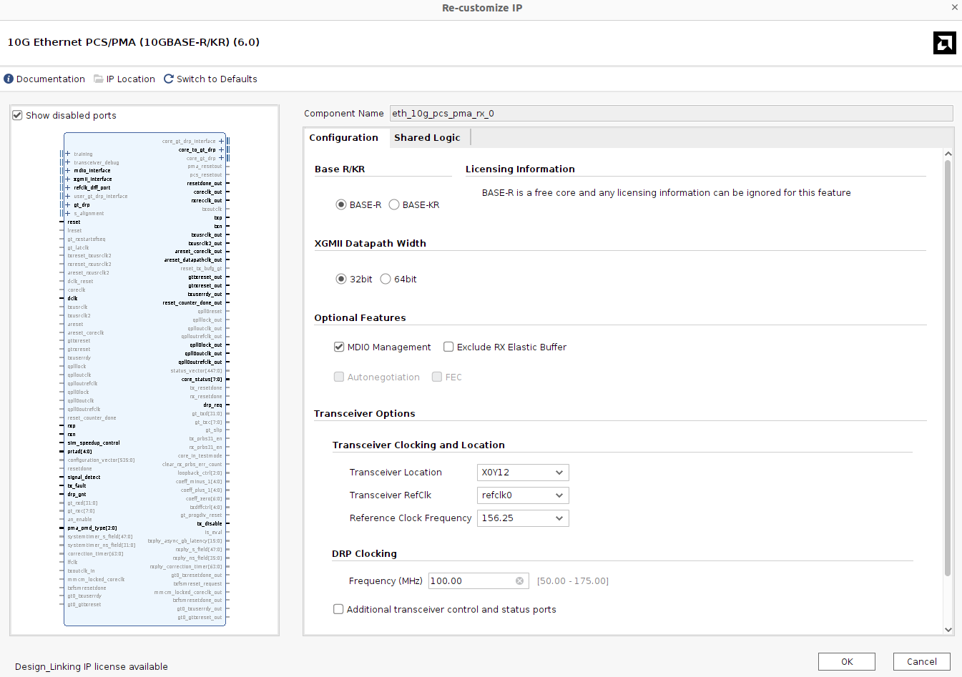
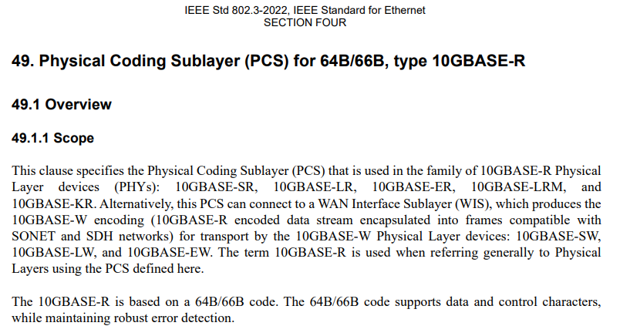
New Module for XGMII TX –
Creating IP for 10G Data Transfer on FPGA TX and RX (2 IP)
Base-R Using 64b/66b Line Encoding,
Following IEEE Ethernet 802.3 Standard
XGMII / Core Clock : 312.5 MHz [31:0]
The transfer capacity of this system is 312.5 MHz times 32-bit, resulting in exactly 10 Gbps.
Our FPGA Board is xcku060-ffva1156-2-i (Kintex UltraScale)
Reference Clock (Physical Oscillator) : 156.25 MHz
Standard frequency of the physical oscillator crystal on the FPGA board for 10G network
‹#›

Slide 35
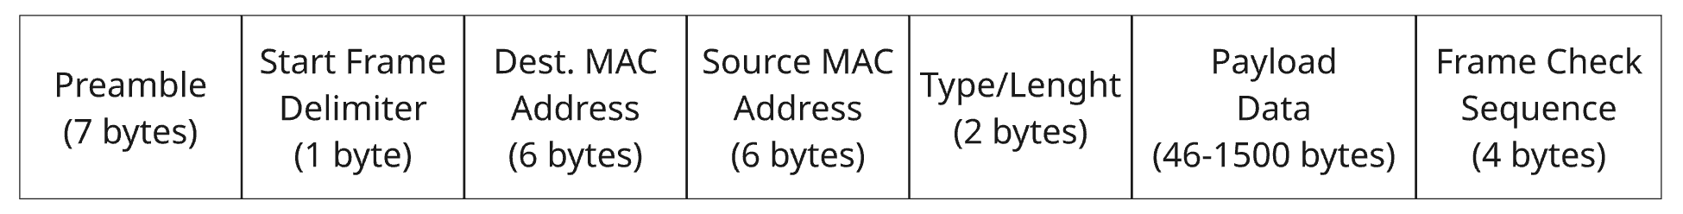
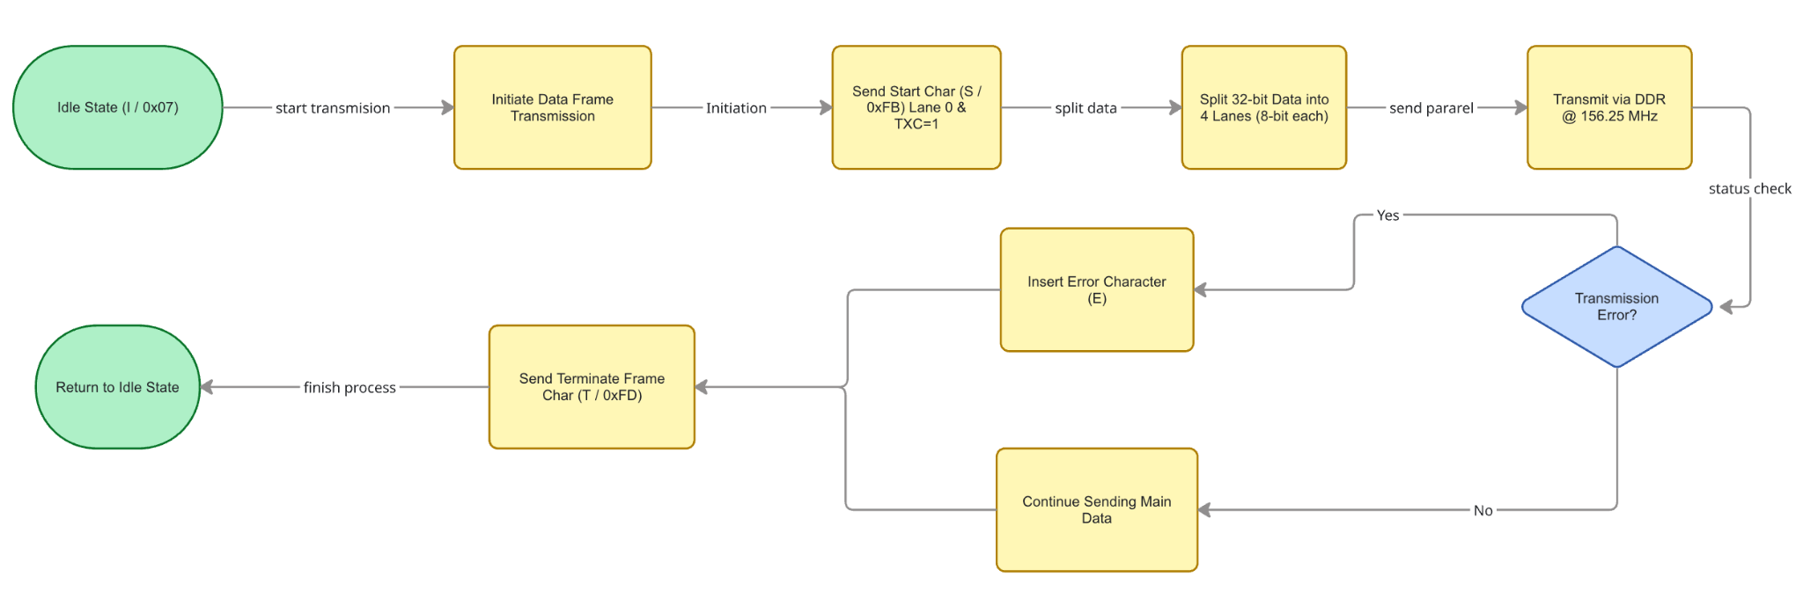
New Module for XGMII TX –
Creating Packet Generator Based on IEEE 802.3
Data Frame Standard Based on IEEE 802.3
Flowchart XGMII
‹#›

Slide 36
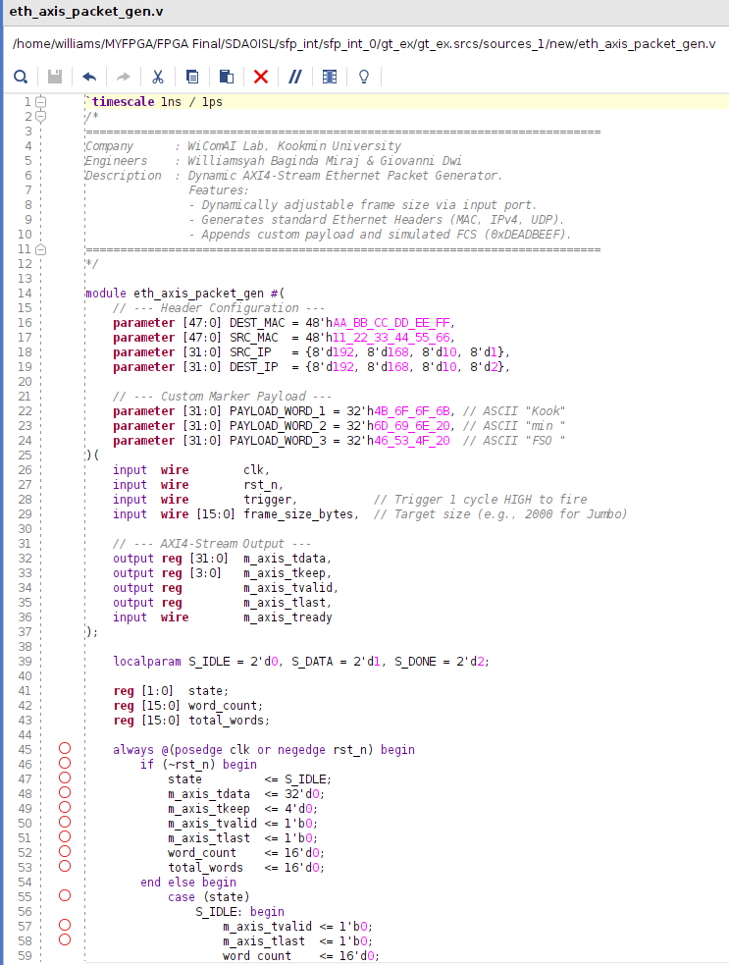
New Module for XGMII TX –
Creating Packet Generator Based on IEEE 802.3
XGMII Module - Trial Packet Generator Process - 2000 byte (Jumbo Frame)
Reason why we choose send jumbo frame
It tests the truncation of a complete block (the first 1900 bytes).
The remaining data (100 bytes) behaves exactly like a Mini Frame, testing the entry of Zero Padding mode.
Back-to-back transmissions force the electrical system (XGMII) to physically create an Inter-Packet Gap (IPG), while the Segmenter is busy padding. This demonstrates the effectiveness of Elastic FIFO.
Core Module for Packet Generator
‹#›

Slide 37
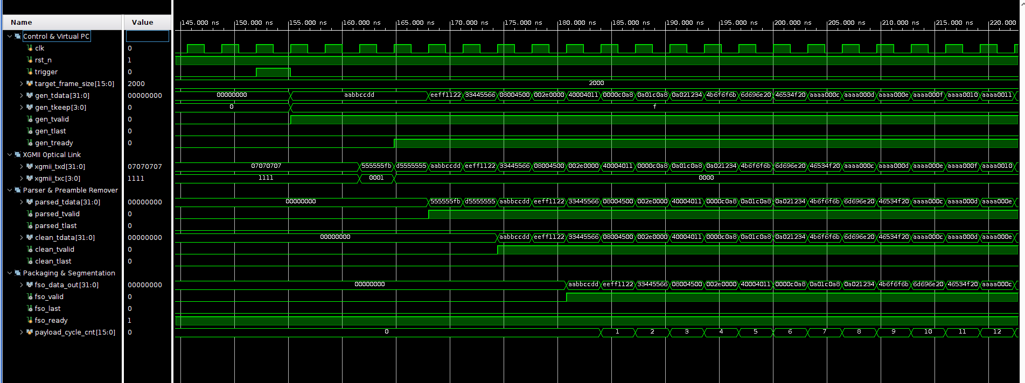
New Module - Creating XGMII Module for 312.5 MHz 32 bit for FPGA TX
XGMII Module - Trial Packet Generator Process - 2000 byte (Jumbo Frame)
(Packet Generator -> XGMII -> Parser -> Preamble Remover -> Packaging and Segmentation)
(Throughput) 312.5 * 32 bit = 10 Gbps
Frame Data – 32-bit/clock
fso_data_out[31:0] outputs 4 bytes of packet data every clock cycle.
IDLE (07070707)
Preamble [55:0] 7 Byte.
Start of Frame Delimiter (SFD) [7:0] 1 Byte
Parsed Data -> Raw Data and Electrical Translator to AXI-Stream
Clean Data -> Discard the first 8 bytes (Preamble and SFD)
FSO Data Out -> Payload Data
‹#›

Slide 38
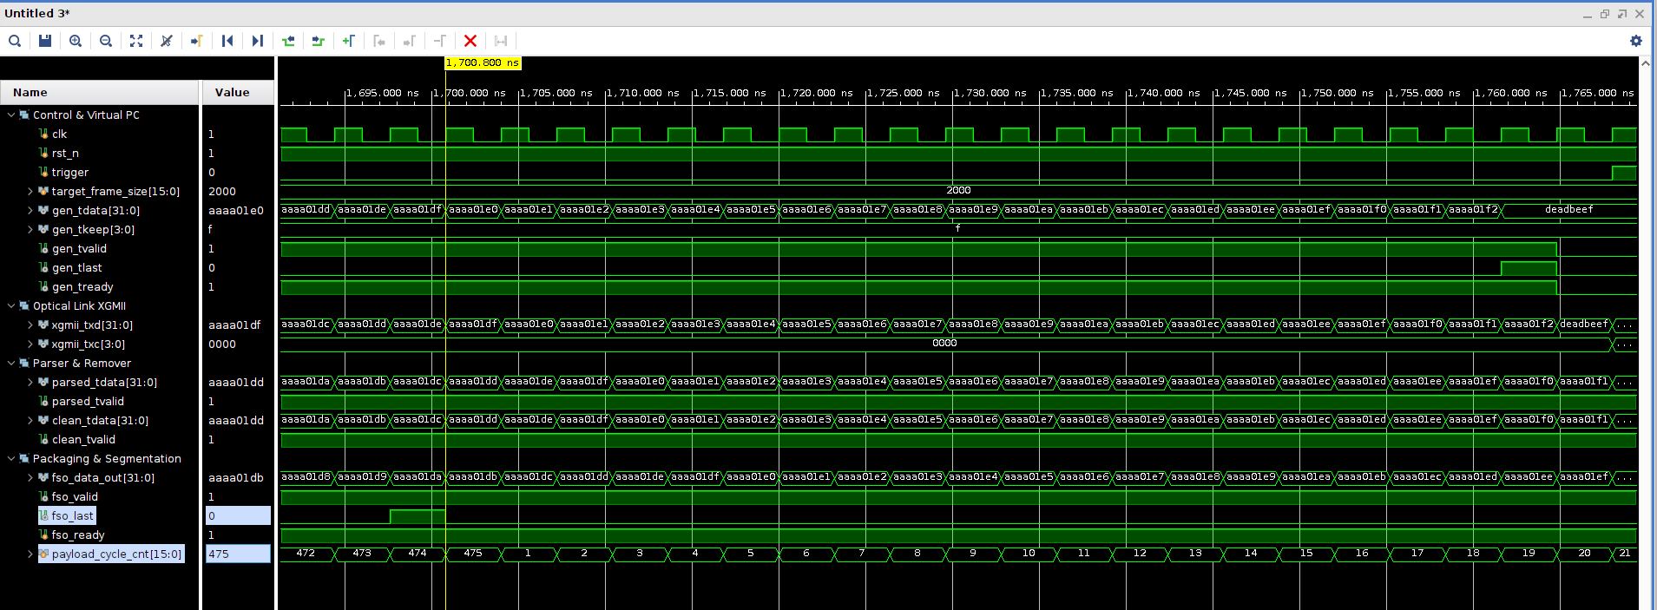
New Module - Creating XGMII Module for 312.5 MHz 32 bit for FPGA TX
XGMII Module - Trial Packet Generator Process - 2000 byte (Jumbo Frame)
(Packet Generator -> XGMII -> Parser -> Preamble Remover -> Packaging and Segmentation)
From a 2000-byte Jumbo Frame, Packaging & Segmentation Module counts exactly 475 cycles (get by 475x4=1908). At exactly the 475th cycle, the fso_last flag is raised to notify the downstream Framer block that a 1908-byte FSO block has been completed and is ready to be packed.
‹#›

Slide 39
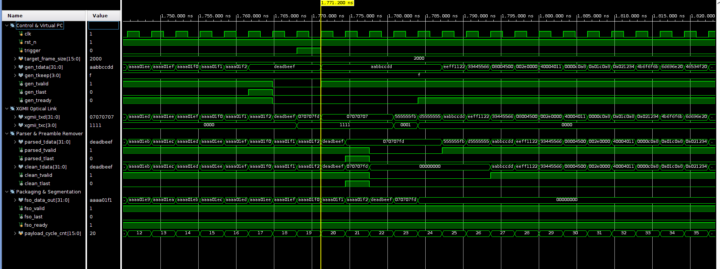
New Module - Creating XGMII Module for 312.5 MHz 32 bit for FPGA TX
XGMII Module - Trial Packet Generator Process - 2000 byte (Jumbo Frame)
(Packet Generator -> XGMII -> Parser -> Preamble Remover -> Packaging and Segmentation)
Jumbo Frame (500 cycles) - Block 1 (475 cycles) = Remaining 25 data cycles.
The segmenter needs 475−25= 450 Zero Padding cycles to complete the second FSO Block.
The second Jumbo Frame enters immediately after the first Jumbo Frame. As per IEEE 802.3 standards, our electrical transmitter forcibly inserts exactly 3 pure IPG clock cycles (07070707). Our Elastic FIFO in the Segmenter absorbs this second Jumbo Frame without killing gen_tready (without backpressure), proving the system is immune to extreme asynchronous traffic.
‹#›

Slide 40
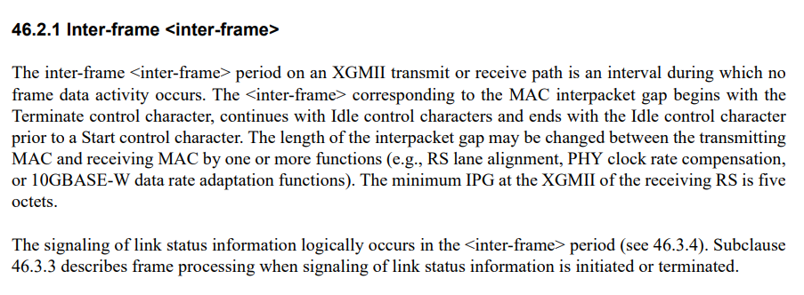
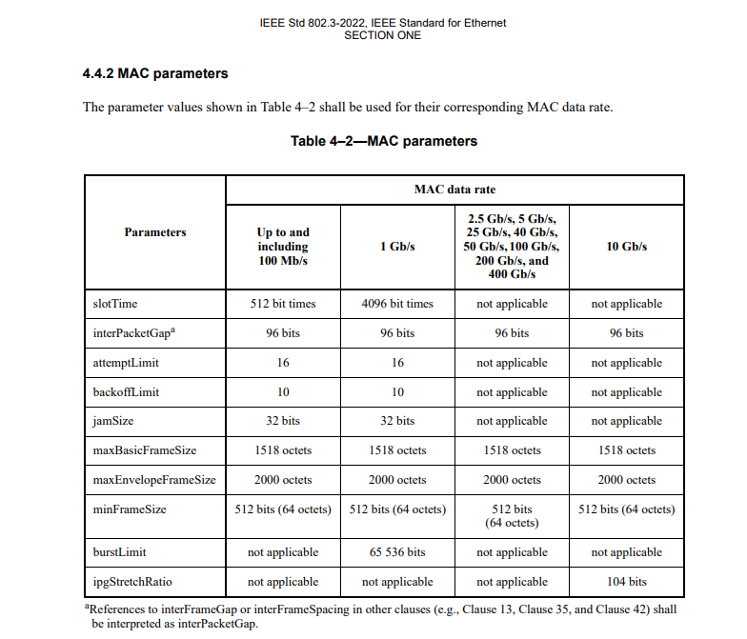
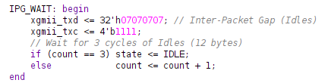
New Module - Creating XGMII Module for 312.5 MHz 32 bit – Inter Packet Gap for FPGA TX and RX
The XGMII standard defines that this pause (IPG) must be filled with an Idle control character.
The Idle character in XGMII is represented by a Data value of 0x07 and a Control Bit of 1.
The MAC standard defines that the minimum distance between Ethernet packets (after the termination character to the start of the next packet) must be 96 bit times.
Our XGMII data line has a width of 32-bits (4 Bytes) per clock cycle.
Inter Packet Gap 12 Byte = 12 / 4 = 3 Clock Cycle.
Our XGMII Code
‹#›

Slide 41
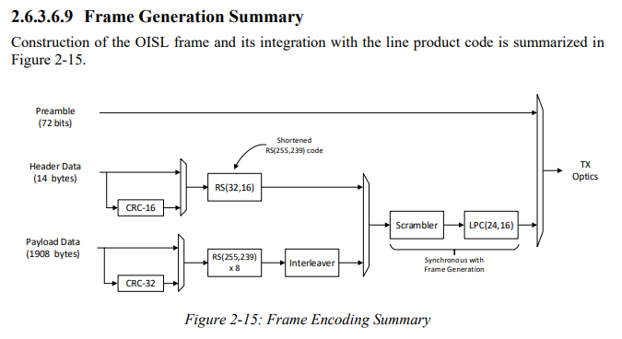
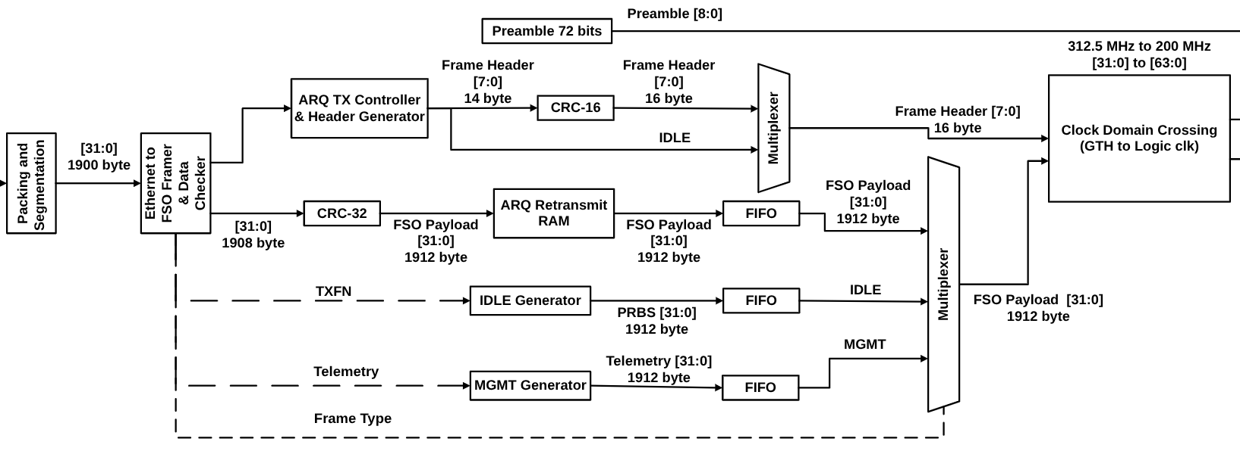
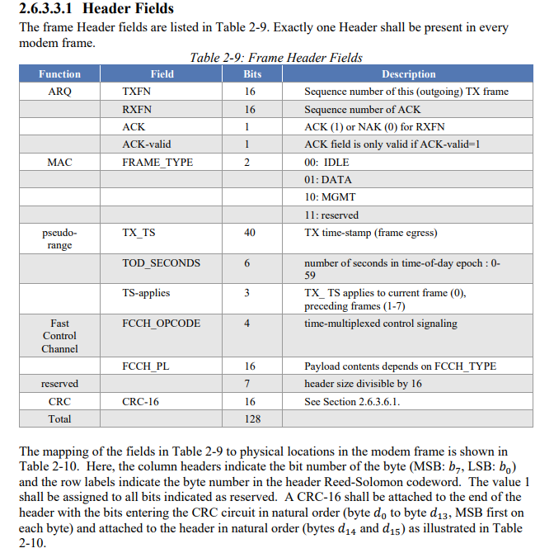
New Module for FSO Payload –
Creating Header Generator, CRC 16 and Header MUX
Core Engine for Header Module (FSO Header Frame following SDA OISL & ARQ following SDA OCT)
Header Generator
Making header following SDA OISL Table 2-9
ARQ TX CONTROLLER
Control ARQ, creating TXFN and receiving RXFN,and ACK or NAK
CRC 16
Header 14 Byte + 2 Byte from CRC 16 = 16 Byte
‹#›

Slide 42
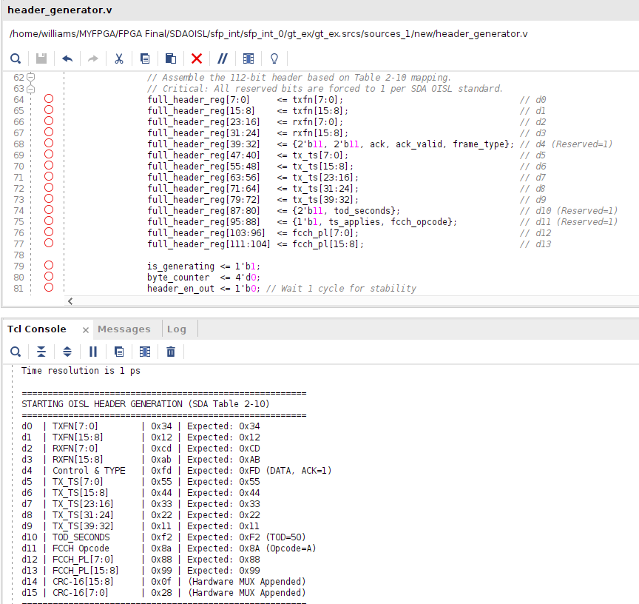
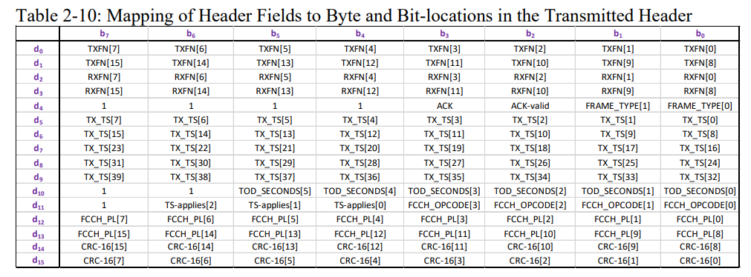
New Module for FSO Frame –
Creating Header Generator, CRC 16 and Header MUX
Mathematical Proof (Setup Phase, following table 2-9 and table 2-10)
Basic Architecture Rules
Reserved Bits Mandate: The SDA OISL standard requires all reserved bits to be set to a logical 1 (not 0).
LSB-First (Little-Endian) Transmission Architecture: For multi-byte data (such as 16-bit TXFN or 40-bit TX_TS), the least significant byte (Least Significant Byte) must be transmitted first.
Simulation Test Parameters: TXFN = 0x1234, RXFN = 0xABCD, FRAME_TYPE = 01 (DATA), ACK/ACK_val = 1, TOD_SECONDS = 50, FCCH_OPCODE = 0xA.
d0 & d1 (TXFN Transmission 0x1234):
d0 = LSB of TXFN -> 0x34.
d1 = MSB of TXFN -> 0x12.
d2 & d3 (RXFN Transmission 0xABCD):
d2 = LSB of RXFN -> 0xCD.
d3 = MSB of RXFN -> 0xAB.
d5 to d9 (TX_TS Transmission 0x1122334455):
Reverse order from the lowest byte: d5=0x55, d6=0x44, d7=0x33, d8=0x22, d9=0x11.
d12 & d13 (FCCH Payload Transmission 0x9988):
d12 = LSB -> 0x88.
d13 = MSB -> 0x99.
‹#›

Slide 43
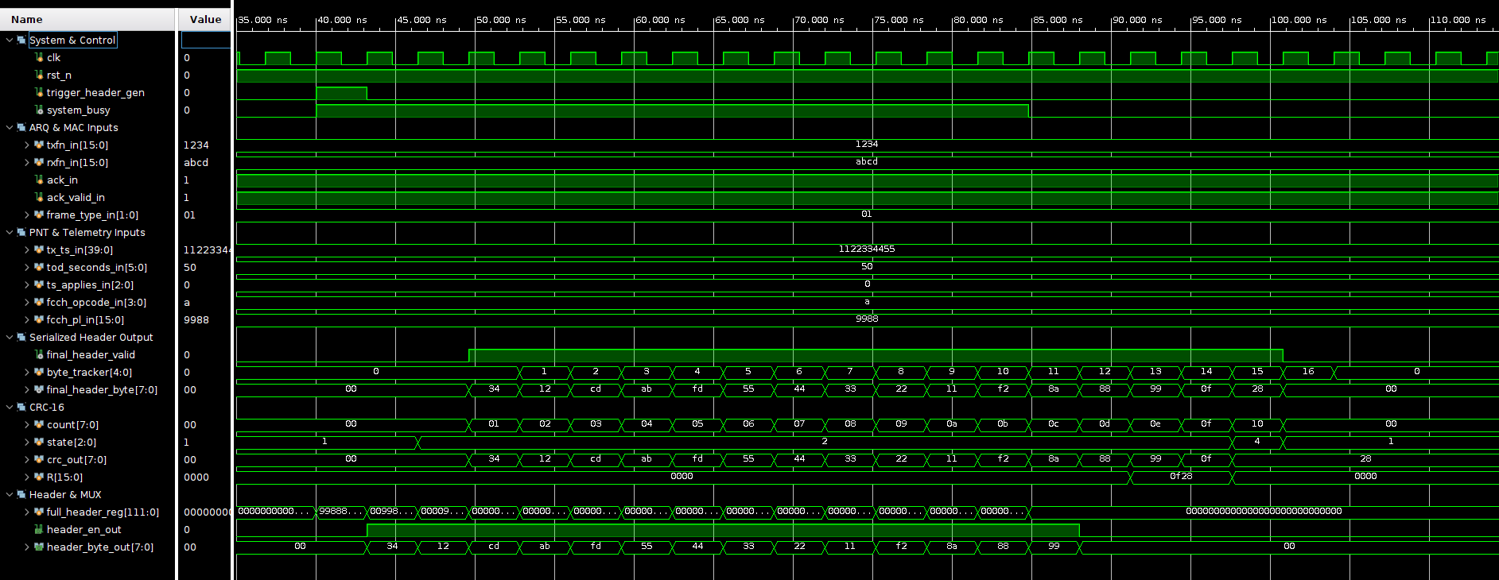
New Module for FSO Frame –
Creating Header Generator, CRC 16 and Header MUX
Asynchronous Parameter Assimilation (Setup Phase, following table 2-9 and table 2-10)
We injected a scenario where TXFN = 0x1234, RXFN = 0xABCD, FRAME_TYPE = 01 (DATA), ACK = 1, and TOD_SECONDS = 50 and FCCH_OPCODE = 0xA.
The signal stability before trigger_header_gen is triggered proves that our system setup time is perfectly met without any risk of metastability.
‹#›

Slide 44
New Module for FSO Frame –
Creating Header Generator, CRC 16 and Header MUX
Core Engine for Header (Setup Phase, following table 2-9 and table 2-10)
Right after trigger_header_gen pulses one cycle, our machine responds instantly. The system_busy signal immediately goes up, locking the system.
The header_en_out signal is now a constant 1 for exactly 14 clock cycles. During these 14 cycles, 112-bit register spits out 8-bit data per clock cycle into the CRC-16 math circuit.
‹#›

Slide 45
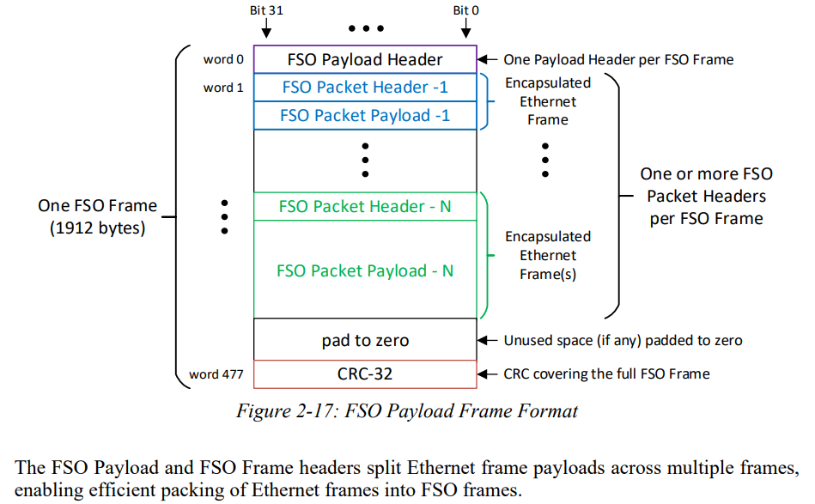
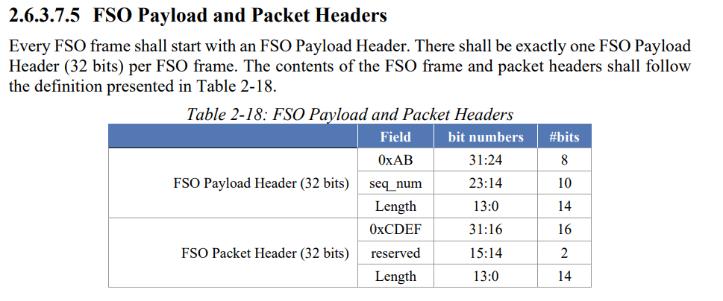
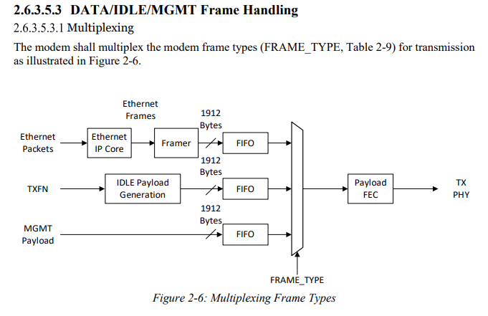
New Module for FSO Frame –
Creating Payload Module, CRC 32, ARQ, FIFO & MUX
Core Engine for FSO Payload (FSO Payload Frame following SDA OISL & ARQ following SDA OCT)
Testing Sending 2000 Byte data
Packaging & Segmentation (Sending 2000 Byte Data)
Divide into 2 data 1900 Byte and 100+1800ZeroPedding Byte Data
FSO Formatter
1900 Byte data from Packaging & Segmentation + 4 Byte FSO Payload Header + 4 Byte FSO Packet Header = 1908 Byte (SDA OISL Table 2-18)
CRC 32
1908 Byte from FSO Formatter + 4 Byte CRC 32 = 1912 Byte (SDA OISL Figure 2-17)
‹#›

Slide 46
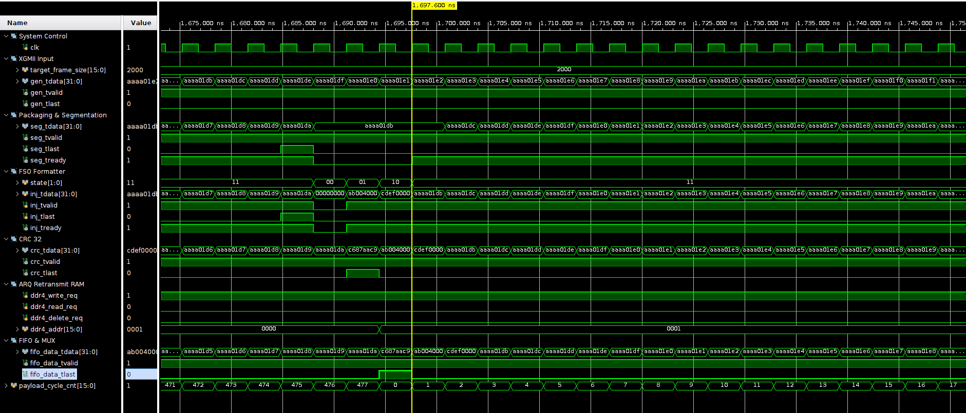
New Module for FSO Frame –
Creating Payload Module, CRC 32, ARQ, FIFO & MUX
Core Engine for FSO Payload (FSO Payload Frame following SDA OISL & ARQ following SDA OCT)
Testing Sending 2000 Byte data
Packaging & Segmentation (Sending 2000 Byte Data)
Divide into 2 data 1900 Byte and 100+1800ZeroPedding Byte Data
FSO Formatter
1900 Byte data from Packaging & Segmentation + 4 Byte FSO Payload Header + 4 Byte FSO Packet Header = 1908 Byte (SDA OISL Table 2-18)
CRC 32
1908 Byte from FSO Formatter + 4 Byte CRC 32 = 1912 Byte (SDA OISL Figure 2-17)
‹#›

Slide 47
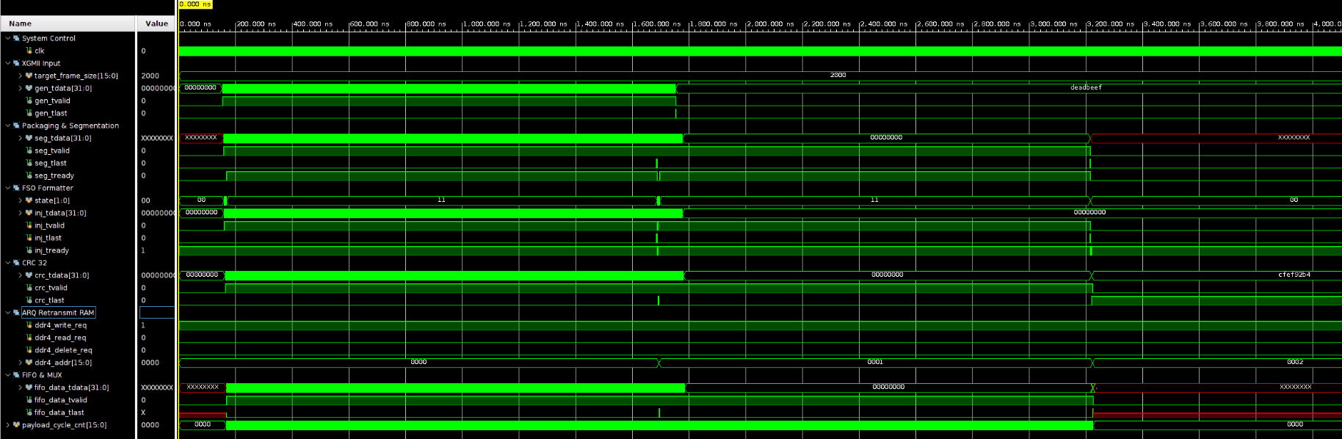
New Module for FSO Frame –
Creating Payload Module, CRC 32, ARQ, FIFO & MUX
Core Engine for FSO Payload (FSO Payload Frame following SDA OISL & ARQ following SDA OCT)
Testing Sending 2000 Byte data
(Divide into 2 data 1900 Byte and 100+1800ZeroPedding Byte Data)
Dual Storage (FIFO & ARQ)
ARQ RAM -> Storage all the Payload Data and repair if NAK
FIFO -> for sending the data to the next FSM (Payload MUX)
‹#›

Slide 48
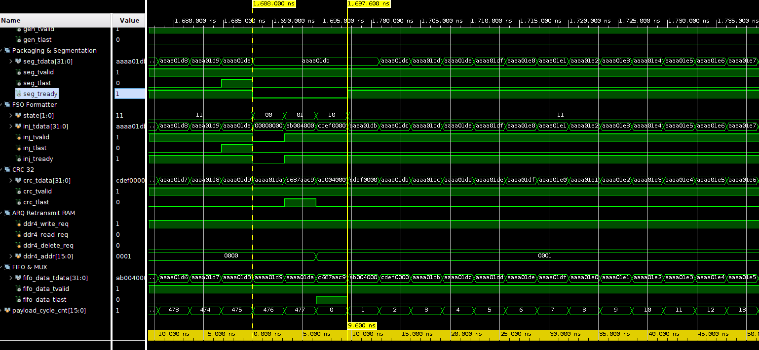
New Module for FSO Frame –
Creating Payload Module, CRC 32, ARQ, FIFO & MUX
Core Engine for FSO Payload (FSO Payload Frame following SDA OISL & ARQ following SDA OCT)
Testing Sending 2000 Byte data
(Divide into 2 data 1900 Byte and 100+1800ZeroPedding Byte Data)
Interpacket GAP only at Ethernet Frame
NO FRAME GAP
When it comes to FSO Frame there is no Frame GAP
‹#›

Slide 49
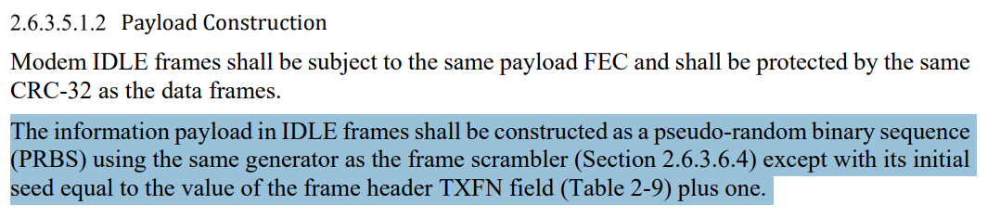
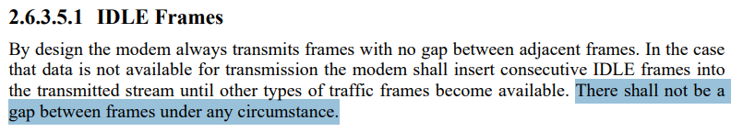
New Module for FSO Frame –
Creating IDLE Module, CRC 32, FIFO & MUX
Core Engine for FSO IDLE Payload (FSO IDLE Payload Frame following SDA OISL)
IDLE Generator(1908 Byte)
Following SDA OISL 2.6.3.5.1.2 that IDLE frames shall be constructed as a pseudo-random binary sequence(PRBS) using the same generator as the frame scrambler
IDLE GENERATOR WITH CRC 32
1908 Byte from FSO IDLE + 4 Byte CRC 32 = 1912 Byte (SDA OISL 2.6.3.5.1.2)
‹#›

Slide 50

New Module for FSO Frame –
Creating IDLE Module, CRC 32, FIFO & MUX
Core Engine for FSO IDLE Payload
FRAMETYPE:00 IDLE
RAW IDLE Data (1908 Byte, or 477 Clock Cycle)
Following SDA OISL 2.6.3.5.1.2 that IDLE frames shall be constructed as a pseudo-random binary sequence(PRBS) using the same generator as the frame scrambler
IDLE with CRC 32
1908 Byte from RAW IDLE Data + 4 Byte CRC 32 = 1912 Byte or 478 Clock Cycle
IDLE Data (1912 Byte) send to FIFO_IDLE and MUX
NO FRAME GAP
‹#›

Slide 51

New Module for FSO Frame –
Creating MGMT Module, CRC 32, FIFO & MUX
Core Engine for FSO MGMT Payload (FSO MGMT Payload Frame following SDA OISL)
MGMT Generator(1908 Byte)
Following SDA OISL 2.6.3.5.2.3 that The MGMT/PNT Frames are used to communicate OISL frame timestamps and calculated range and range timestamp between the OISLs. Table 2-14 defines the MGMT/PNT payload.
MGMT GENERATOR WITH CRC 32
Starting from Padding 229 bits to 256 bits (32 bytes) MGMT + 1876 Byte Zero Padding + 4 Byte CRC 32 = 1912 Byte
‹#›

Slide 52



New Module for FSO Frame –
Creating MGMT Module, CRC 32, FIFO & MUX
Core Engine for FSO MGMT Payload
(FSO MGMT Payload Frame following SDA OISL)
‹#›

Slide 53

New Module for FSO Frame –
Creating MGMT Module, CRC 32, FIFO & MUX
Core Engine for FSO MGMT Payload
(FSO MGMT Payload Frame following SDA OISL)
Range Meter = 5000 KM
confirms that the IEEE 754 Double Precision (64-bit) format is perfectly captured by our architecture. The simulated optical link (Space-to-Space) distance is set at an extreme distance of 5,000 kilometers (5,000,000 meters), which is the target specification for the Cross-Plane orbit SDA constellation.
‹#›

Slide 54
New Module for FSO Frame –
Creating MGMT Module, CRC 32, FIFO & MUX
Core Engine for FSO MGMT Payload
(FSO MGMT Payload Frame following SDA OISL)
Range_ts_sec = 57f9f900 (Hexadecimal) or 1.476.000.000 in decimal
The satellite system uses the GPS Epoch (starting on January 6, 1980). The number 1,476,000,000 seconds represents an increase of approximately 46.77 years since that Epoch on this simulation test (October 9,2026)
‹#›

Slide 55

New Module for FSO Frame –
Creating MGMT Module, CRC 32, FIFO & MUX
Core Engine for FSO MGMT Payload
MGMT Generator work parallel to prepare the Telemetry data, as here we see while the frame type still 00, MGMT already prepare the 1908 Byte Telemetry Data (SDA OISL Table 2-14)
Padding 229 bits to 256 bits (32 bytes) MGMT + 1876 Byte Zero Padding = 1908 Byte
1908 Byte Raw MGMT Data + 4 Byte crc 32 = 1912 Byte or 478 Clock Cycle
As we can see MGMT Store to FIFO_MGMT.
Starting from Padding 229 bits to 256 bits (32 bytes) MGMT + 1876 Byte Zero Padding + 4 Byte CRC 32 = 1912 Byte
‹#›

Slide 56



Update Module for FSO Frame –
Update Module for Cyclic Redundancy Check
Core Engine for CRC 16 & CRC 32
CRC 16 [7:0] -> Location Frame Header. 14 Byte Data from Header Generator + 2 Byte CRC 16 = 16 Byte
We follow SDA OISL 2.6.3.6.1
CRC 32 [31:0] -> Location Frame Payload. 1908 Byte Data from FSO Payload + 4 Byte CRC 32 = 1912 Byte
‹#›

Slide 57


Update Module for Clock Domain Crossing 312.5 MHz to 200 MHz –
Update Module for CDC Header and CDC Payload
FIFO and Clock Domain Crossing
FIFO and Clock Domain Crossing for FSO Header
FIFO and Clock Domain Crossing for FSO Payload
Input Side (Framer to CDC): The speed is 312.5 MHz × 32 bit = 10 Gbps 312.5 MHz × 32-bit = 10 Gbps.
Output Side (CDC to FEC): The speed is 200.0 MHz × 64 bit = 12.8 Gbps 200.0 MHz × 64-bit = 12.8 Gbps.
‹#›

Slide 58


Update Module for FSO Frame –
Update Module for CRC
FIFO and Clock Domain Crossing (Testing Sending Jumbo Frame 2000 Byte)
2000 Byte -> Divide to 2 Data. Data 1 (1912 Byte) + Data 2 (112 Byte Data+1800 Byte Zero Padding)
Data Input From Framer TX to FIFO and Clock Domain Crossing
No Gap Between Data 1 and Data 2. It solved for Inter-Packet Gap
‹#›

Slide 59

Update Module for FSO Frame –
Update Module for CRC
FIFO and Clock Domain Crossing (Testing Sending Jumbo Frame 2000 Byte)
2000 Byte -> Divide to 2 Data. Data 1 (1912 Byte) + Data 2 (112 Byte Data+1800 Byte Zero Padding)
The FSM in the CDC intentionally holds the payload for 164 cycles to wait for the FEC (Reed-Solomon) to finish calculating the parity of the header. In the final MUX Gearbox, this 164-cycle gap will be precisely filled by the 72-bit preamble and parity RS, so that the final flow to the optical laser (GTH) returns to continuous without any gap.
FEC Latency
‹#›

Slide 60

Module for FEC Reed Solomon –
Module for RS Header
Reed Solomon for Header Data. RS (32,16)
- Input Header : 16 Cycles x 1 Byte = 16 Bytes or 2 Words
- RS Head Out : 32 Cycles x 1 Byte = 32 Bytes or 4 Words
FSO Header Data 16 Byte
FSO Header Data 16 Byte (Active Phase)
FSO Header RS Parity Data 16 Byte (Flush Phase)
‹#›

Slide 61

Module for FEC Reed Solomon –
Module for RS Payload
Reed Solomon for Payload Data. RS (255,239)
FSO Payload Data 1912 Byte
(Active Phase)
FSO Payload Parity Data 128 Byte (Flush Phase)
- Input Payload : 239 Cycles x 8 Byte = 1912 Bytes or 239 Words
- RS Load Out : 255 Cycles x 8 Byte = 2040 Bytes or 255 Words
‹#›

Slide 62


Module for FEC Multiplexer –
Module for FEC Multiplexer
Multiplexer from RS Solomon. Merge FSO Header Data and FSO Payload Data
Combiner
FSO Header with RS Parity Data:
32 Byte (4 Words)
FSO Payload with RS Parity Data:
2040 Byte (255 Words)
Data Out: 32+2040=2072 Byte(259 Words)
‹#›

Slide 63


Module for Scrambler –
Module for Scrambler
Scrambler Data
The scrambler randomizes the bit sequence before transmission. Its purpose is to avoid long, consecutive strings of '0' or '1' bits, maintaining Direct Current balance and ensuring successful clock recovery on the receiving device (GTH Transceiver).
The randomization process is carried out through a pure XOR logic operation between the 64-bit input data (data_in_d0) and the active PRBS state vector (S). For each pair of bytes entering the scrambler, the bits shall enter the scrambler in the order byte 0 (MSB) to byte 1 (LSB).
‹#›

Slide 64



Module for Scrambler –
Module for Scrambler
Scrambler Data
Data from FEC Multiplexer
2072 Byte
Scrambler Data
2072 Byte
‹#›

Slide 65



Module for Line Product Code –
Module for LPC (24,16)
LPC Data
LPC serves as a secondary layer Forward Error Correction (FEC) mechanism after Reed-Solomon. This compression method detects and corrects additional bit errors that may occur during optical transmission.
Distributes the 64-bit bus of the Scrambler into four parallel lines of 16 bits each. These four lines are processed simultaneously by four instances of the lpc submodule (lpc_3 to lpc_0).
In each lpc.v sub-module, the 16-bit input is first mapped into the encryption component of the matrix E[0:15]. Then, the module computes the Horizontal (H[0:3]) and Vertical (V[0:3]) vectors using high-speed cascaded linear XOR equations.
‹#›

Slide 66
Module for Line Product Code –
Module for LPC (24,16)
LPC Data
Data from FEC Multiplexer
2072 Byte
Scrambler Data
2072 Byte
‹#›

Slide 67





New Module for Preamble Generator –
Module for Preamble Sequence (24,16)
5555555555555555d5 -> 72 bit or 9 byte
Show that preamble data 72 bit (9 Byte) already been transfer without scrambled and LPC
‹#›

Slide 68
New Module for Preamble –
Module for Multiplexer for LPC Data and Preamble
Data from LPC (24,16) -> 3108 Byte
Preamble Data -> 9 Byte
Total = 3108 Byte (LPC) + 9 Byte (Preamble) = 3117 Byte or 24936 bits.
Byte 1 to Byte 9 (9 bytes / 72 bits): Preamble (Pure, unscrambled, used by the Frame Synchronizer at the receiver as a reference for the frame zero point).
Byte 10 to Byte 57 (48 bytes / 384 bits): Encoded Header (derived from the 32-byte RS Header that has been scrambled and expanded by LPC 16/24 to 48 bytes).
Byte 58 to Byte 3117 (3060 bytes / 24,480 bits): Encoded Payload (derived from the 2040-byte RS Payload that has been scrambled and expanded by LPC 16/24 to 3060 bytes).
‹#›

Slide 69

Update Module for Clock Domain Crossing –
Module for CDC Logic Clk to GTH
We put same condition sending 2000 Byte.
2000 Byte -> Divide to 2 Data Frame.
Data In from Multiplexer to CDC
3117 Byte or 24936 bits
Data Out from CDC to GTH
3117 Byte or 24936 bits
‹#›

Slide 70
Update Module for Clock Domain Crossing –
Module for CDC Logic Clk to GTH
We put same condition sending 2000 Byte.
2000 Byte -> Divide to 2 Data Frame.
This interval is not an optical transmission pause, but a Bandwidth Rate-Matching mechanism.
Write Domain (200 MHz x 128 bit)
Read Domain (312.5 MHz x 32 bit)
At the 10.0 Gbps optical line rate, transmitting one complete 24,936-bit OISL frame requires 2.4936 μs for frame duration
(24,936 bit / 10 Gbps= 2.4936 μs or 2493.6 in nanosecond)
However, because the 128-bit write bus operates at a 25.6 Gbps burst rate, the MUX Gearbox finishes writing all 3117 Bytes into the CDC FIFO in just 975.0 ns.
To match the 10.0 Gbps average line rate and prevent FIFO overflow, the write interface remains idle for the remaining 304 clock cycle
(24933.6 ns-975.0 ns ≈ 1520.0 ns or 304 clock cycle)
while the upstream FEC/LPC pipeline processes the next frame.
NO GAP.
synchronous with no pauses between frames and no pauses
‹#›

Slide 71

Update Module for Clock Domain Crossing –
Module for CDC Logic Clk to GTH
We put same condition sending 2000 Byte.
2000 Byte -> Divide to 2 Data Frame.
Data In from Multiplexer to CDC
3117 Byte or 24936 bits
‹#›

Slide 72

Update Module for Clock Domain Crossing –
Module for CDC Logic Clk to GTH
We put same condition sending 2000 Byte.
2000 Byte -> Divide to 2 Data Frame.
Data Out from CDC to GTH
3117 Byte or 24936 bits
Sending continuously without any gap. Data 1 and Data 2
Following SDA OISL “Transmission of modem frames shall be synchronous with no pauses between frames and no pauses between any of the bits comprising the frame components in Table 2-8. From the values in Table 2-8, the total frame size shall be 72+384+24480=24936 bits.”
‹#›

Slide 73
Update Module for Clock Domain Crossing –
Module for CDC Logic Clk to GTH
Baud Rate | Frame Duration | Effective Data Rate | Frame Rate | Fast Control Channel
10000 Mbaud (312.5 MHz x 32 Bit = 10 Gbps) | 2.4936 us (In this slide show 2,493.600 ns) | 6121.270 Mbps (6,121 Gbps) | 401.0266 kHz | 6.416 Mbps
Data Rate for one data
‹#›

Slide 74



New Module for Error Inject –
Module for Error Inject for Simulation Mode and Hardware Mode
In Here we make 2 mode error injector
Simulation Mode -> using Digital Memory Injection Active (error.mem)
The error.mem file contains 48 rows of 32-bit words (index 0 to 47, total 48×4 Bytes=192 Bytes).
XOR the 32 bit data stream with hexadecimal data from error.mem
Hardware Mode -> Digital Bypass + Active VOA Manual Hardware (Single Mode 0.9-1m /t49G/51 LC/PC)
3117 bytes of data pass through the GTH TX and SFP+ TX with the same pipe latency. Bit errors are then physically generated in the real world by turning the damping screw on the Manual Variable Optical Attenuator (LC/PC /t49G/51)
Manual Variable Attenuator (Single Mode)-0.9-1m /t49G/51
Connector type: LC/PC. Brand : Fiberpia
‹#›

Slide 75
New Module for Error Inject –
Module for Error Inject for Simulation Mode
Simulation Mode -> using Digital Memory Injection Active (error.mem)
The error.mem file contains 48 rows of 32-bit words (index 0 to 47, total 48×4 Bytes=192 Bytes).
XOR the 32 bit data stream with hexadecimal data from error.mem
3 Operational Zones:
Zone 1 – Preamble & Header Protection -> For the first 15 words (60 bytes = Byte 1 to Byte 60), which includes 9 bytes of preamble + 48 bytes of LPC header + 3 bytes of margin
Zone 2 – Payload Error Injection -> From word 16 to word 63 (48 words = 192 bytes, i.e., Byte 61 to Byte 252), the module reads 48 lines of the garbled pattern from error.mem and XORs them with the payload data.
Zone 3 – Payload Remainder Pass-Through -> From word 64 to byte 3117 (the remaining 2865 bytes, i.e., Byte 253 to Byte 3117), the data Pass-Through. Right on reaching Byte 3117, the FSM immediately rolls back to Zone 1 (IDLE) to protect the Preamble of the next frame without ever dropping the gth_tx_valid_out signal.
‹#›

Slide 76

New Module for Error Inject –
Module for Error Inject for Simulation Mode
We put same condition sending 2000 Byte.
2000 Byte -> Divide to 2 Data Frame.
Data In from CDC transfer 3117 Byte to Error Inject
Data Out From transfer 3117 Byte to GTH
Zone 1 – Preamble & Header Protection -> Byte 1 to Byte 60
Zone 2 – Payload Error Injection -> Byte 61 to Byte 252
Zone 3 – Payload Remainder Pass-Through -> Byte 253 to Byte 3117
‹#›

Slide 77

New Module for Error Inject –
Module for Error Inject for Simulation Mode
Error Inject with Error.mem for Simulation Mode
Data In from CDC transfer 3117 Byte to Error Inject
Data Out to GTH (Error Injected)
Data from CDC XOR with error.mem data
‹#›

Slide 78

New Module for Gigabit Transceiver High Performance (GTH) –
Module for GTH TX
GTH TX from FPGA 1 to GTH RX FPGA 2
Data transfer from FPGA 1 -> all the frame duration, data rate still same
‹#›

Slide 79


New Module for Gigabit Transceiver High Performance (GTH) –
Module for GTH TX
GTH TX from FPGA 1 to GTH RX FPGA 2
Data In from Error Injector
(322.265625 MHz = 312.5 MHz x (66/64))
Data Out from GTH TX FPGA 1
(bit-reversal so that the MSB is sent first optically)
‹#›

Slide 80

New Module for Gigabit Transceiver High Performance (GTH) –
Module for GTH RX
GTH RX FPGA 2
Data Receive from FPGA 1 -> all the frame duration, data rate still same
‹#›

Slide 81



New Module for Gigabit Transceiver High Performance (GTH) –
Module for GTH RX
GTH RX FPGA 2
Data In from Error Injector
Data Out from GTH TX FPGA 1
(bit-reversal so that the MSB is sent first optically)
Data Out from GTH RX -> Bit Reversal Restoration
module reversing the order of bits detects the first word Preamble FSO (32'h5555_555555), and writes 3117 Byte valid data
‹#›

Slide 82


Update Module for Clock Domain Crossing –
Module CDC GTH to Logic Clk
CDC for GTH 312.5 MHz to Logic Clk 200 MHz)
Data from GTH RX
Data out from CDC
all the frame duration, data rate still same
‹#›

Slide 83
System Architecture following SDA OCT (2027)

Slide 84

System Architecture following SDA OCT(2027)
‹#›

Slide 85

System Architecture following SDA OCT(2027)
‹#›

Slide 86
System Architecture following ESA ESTOL(2028)

Slide 87

System Architecture following ESA ESTOL(2028)
‹#›

Slide 88

System Architecture following ESA ESTOL(2028)
‹#›

